Slide 1


Slide 2


Our Church is part of Vibrant Faith’s Creating a Culture of Calling (C3) Project.

Slide 3
Callings
are about
Who we are
How we live
And what we give our lives to.

Slide 4
Our callings are the way that we participate
in God’s activity in the world today .

Slide 5
God sustains creation through our callings.

Slide 6
Callings are about ALL of life—our family, church, community, world

Slide 7
And not just what we do in our work life.

Slide 8
Our first calling comes from God.

Slide 9
God calls us into relationship

Slide 10
And into a life of discipleship.

Slide 11
Our response to God’s calling

Slide 12
is a life of living out our callings.

Slide 13
Some people experience their callings like an acorn.
A small seed that grows over time.

Slide 14
For others, callings are like a journey, with stops along the way.

Slide 15
And for still others, CALLINGS are surprising discoveries!

Slide 16
I am called…
by God
to follow
as I am
from grief
for service
in suffering
through others
within God.

Slide 17
God does not create you with a calling…
but with the capacity for callings…
I am called…….by God.

Slide 18
Your calling becomes
Another one of God’s creative acts…

Slide 19
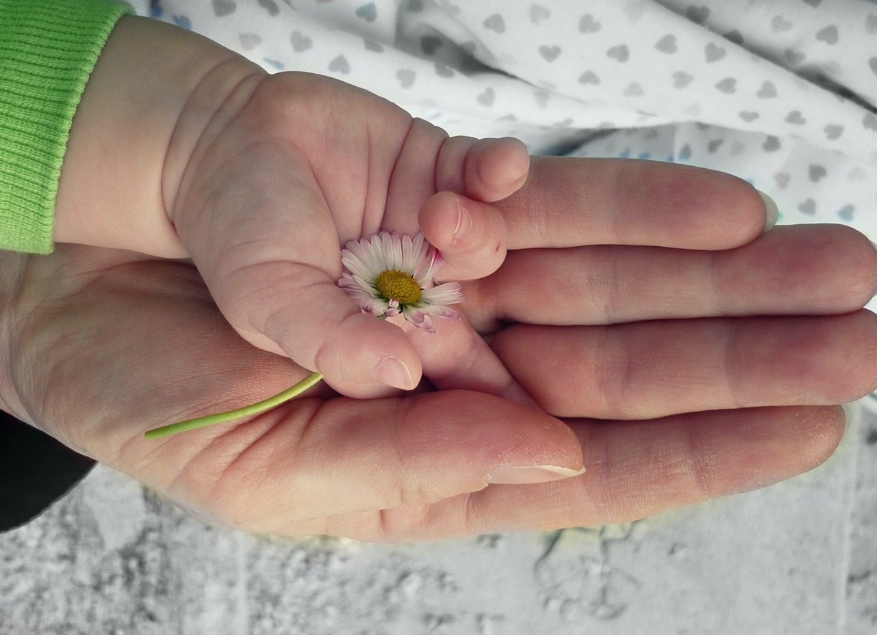
…something we create with God and others,
unique to each of our lives.

Slide 20
I am called…. to follow.
Followers of Christ are stewards, and caregivers, and prophets, and neighbors, and witnesses.

Slide 21
Followers of Christ are called to relationships, to specific roles, to ways of being, to particular gifts and abilities.

Slide 22
I am called…..as I am.
God calls you in the particularities of YOUR life:
I can only become the person I am called to become
in the context of my own life.

Slide 23
Calling is about the WHOLE of your life
So…KEEP PAYING ATTENTION
Your WHOLE life long.

Slide 24
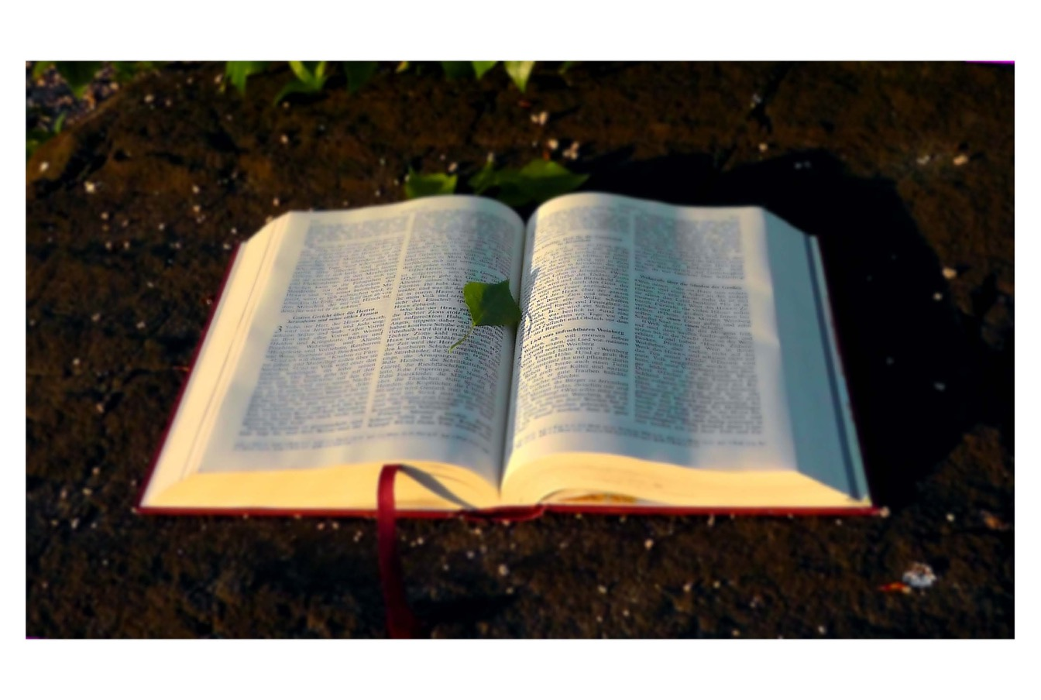
God’s steadfast love endures forever and his faithfulness to all generations -Ps. 100 v.5

Slide 25
I am called….
from grief.
“God is continually calling us to new life, from our old ways, from our losses, from what has ended, into new ways, relationships, and beginnings”

Slide 26
Calling means living into a lifelong theme of finding and losing.

Slide 27
Wherever you go, I will go. Your people will my people and your God my God.
-Ruth 1:16

Slide 28
I am called…..for service
God’s call to you is for love of neighbor, and for service to the world.

Slide 29
The process of calling involves God, the person who is called, and the neighbor whom God loves.

Slide 30
Callings are guided by love—loving God with all our mind, heart, soul,
and strength, and our neighbor as ourselves.
You have a purpose!

Slide 31
I am called…..through others
callings are discerned through relationships—
God calls us through each other
and our calling is for each other.

Slide 32
Discernment of our callings needs to be a regular practice in our churches.

Slide 33
Who comes into your life may be the single greatest factor of influence to what your life becomes.

Slide 34
Who helped you name your callings?

Slide 35
I am called…..in suffering.
Being faithful to our callings will mean times of struggle, darkness, and being overwhelmed.

Slide 36
There are times when calling entails suffering and pain.

Slide 37
It may not be what you want, where you want to be, or where your gifts lie. But it is where you are.

Slide 38
In that place, you ask: God, what are you calling me to in this circumstance?

Slide 39
I am called…..within God.
God comes to dwell within us—
And calls each of us to live in GOD.
God is our source and our destiny.

Slide 40
How lovely is your dwelling place, O Lord of Hosts.
Psalm 84:1

Slide 41
Callings are all around us…

Slide 45
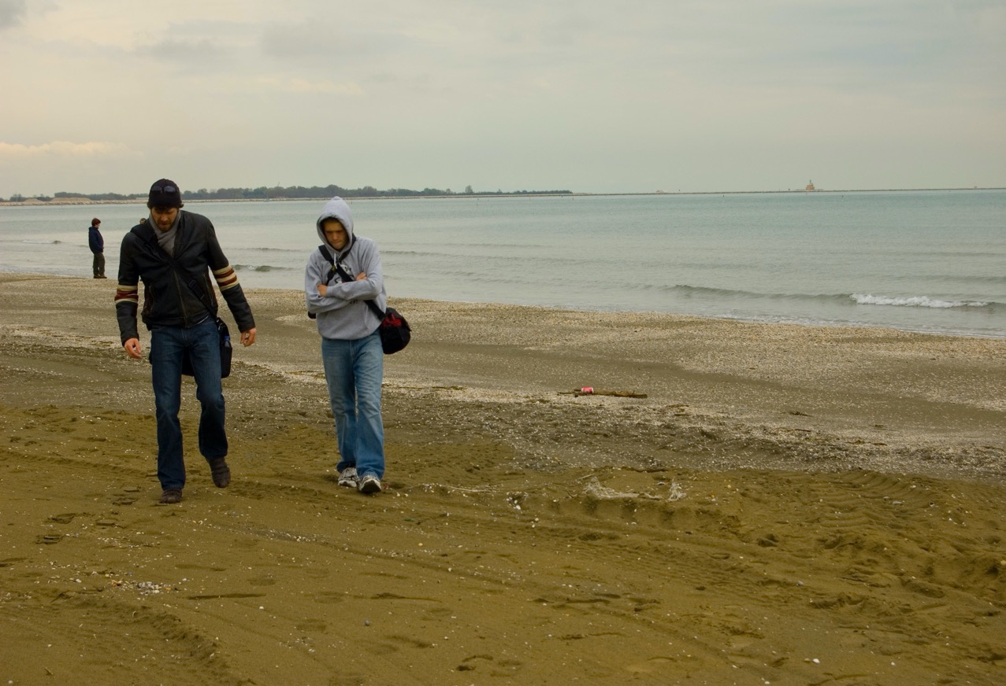

Slide 46
Living our callings transforms you and me….
and the world.

Slide 47
*Presentation based off of the text from Kathleen Cahalan’s book, The Stories we Live

