Slide 1
THRIVING CONVERSATIONS

Slide 2
Facilitator Instructions
BEFORE beginning the first group discussion …
You can divide up the packets of Visual Faith image cards we sent you, so that each person on your team has some, since we assume you can’t meet in person. There is also a slide of images for each session in this ppt.
2. Learn about the visual faith practice. You will use this practice in each of the sessions.
See https://www.vibrantfaithprojects.org/visual-faith-project.html
Read the web page
View the two visual faith training videos
“An Introduction” and “Going Deeper”
3. There are four “Conversations” for your team to work through. Choose at least two. The last one (Revelation) you will do together with your coach and cohort.
The big questions to keep in mind as you facilitate each session are:
How does God desire for God’s people to thrive?
Where do we experience this kind of thriving as a church—for our world?
The outcomes for these THRIVING CONVERSATIONS are:
Each TC team to create a “collage” of images that shows what thriving looks like for their church. This collage will be added to as you
Each TC church will use these conversations to begin their planning for innovation to THRIVE.

Slide 3
THRIVING CONVERSATIONS
Creation
Isaiah 58
Matthew 6
Acts 2

Slide 4
CREATION
Genesis 1

Slide 5
BEGIN
TAKE TIME TO PRAY
Thank God for God’s presence among us.
Ask God for wisdom in understanding what it means to thrive as a congregation and the courage to live into God’s grace in the world you created-- local, nationally and globally.
PICK AN IMAGE
Look through the images and select whichever one “speaks” to or “resonates” with you about “God as Creator”.
UNPACK IMAGES
Take time for each person to share their picture.
What drew you to your image?
What’s the story of your image?
What does your image say about God as Creator?

Slide 6
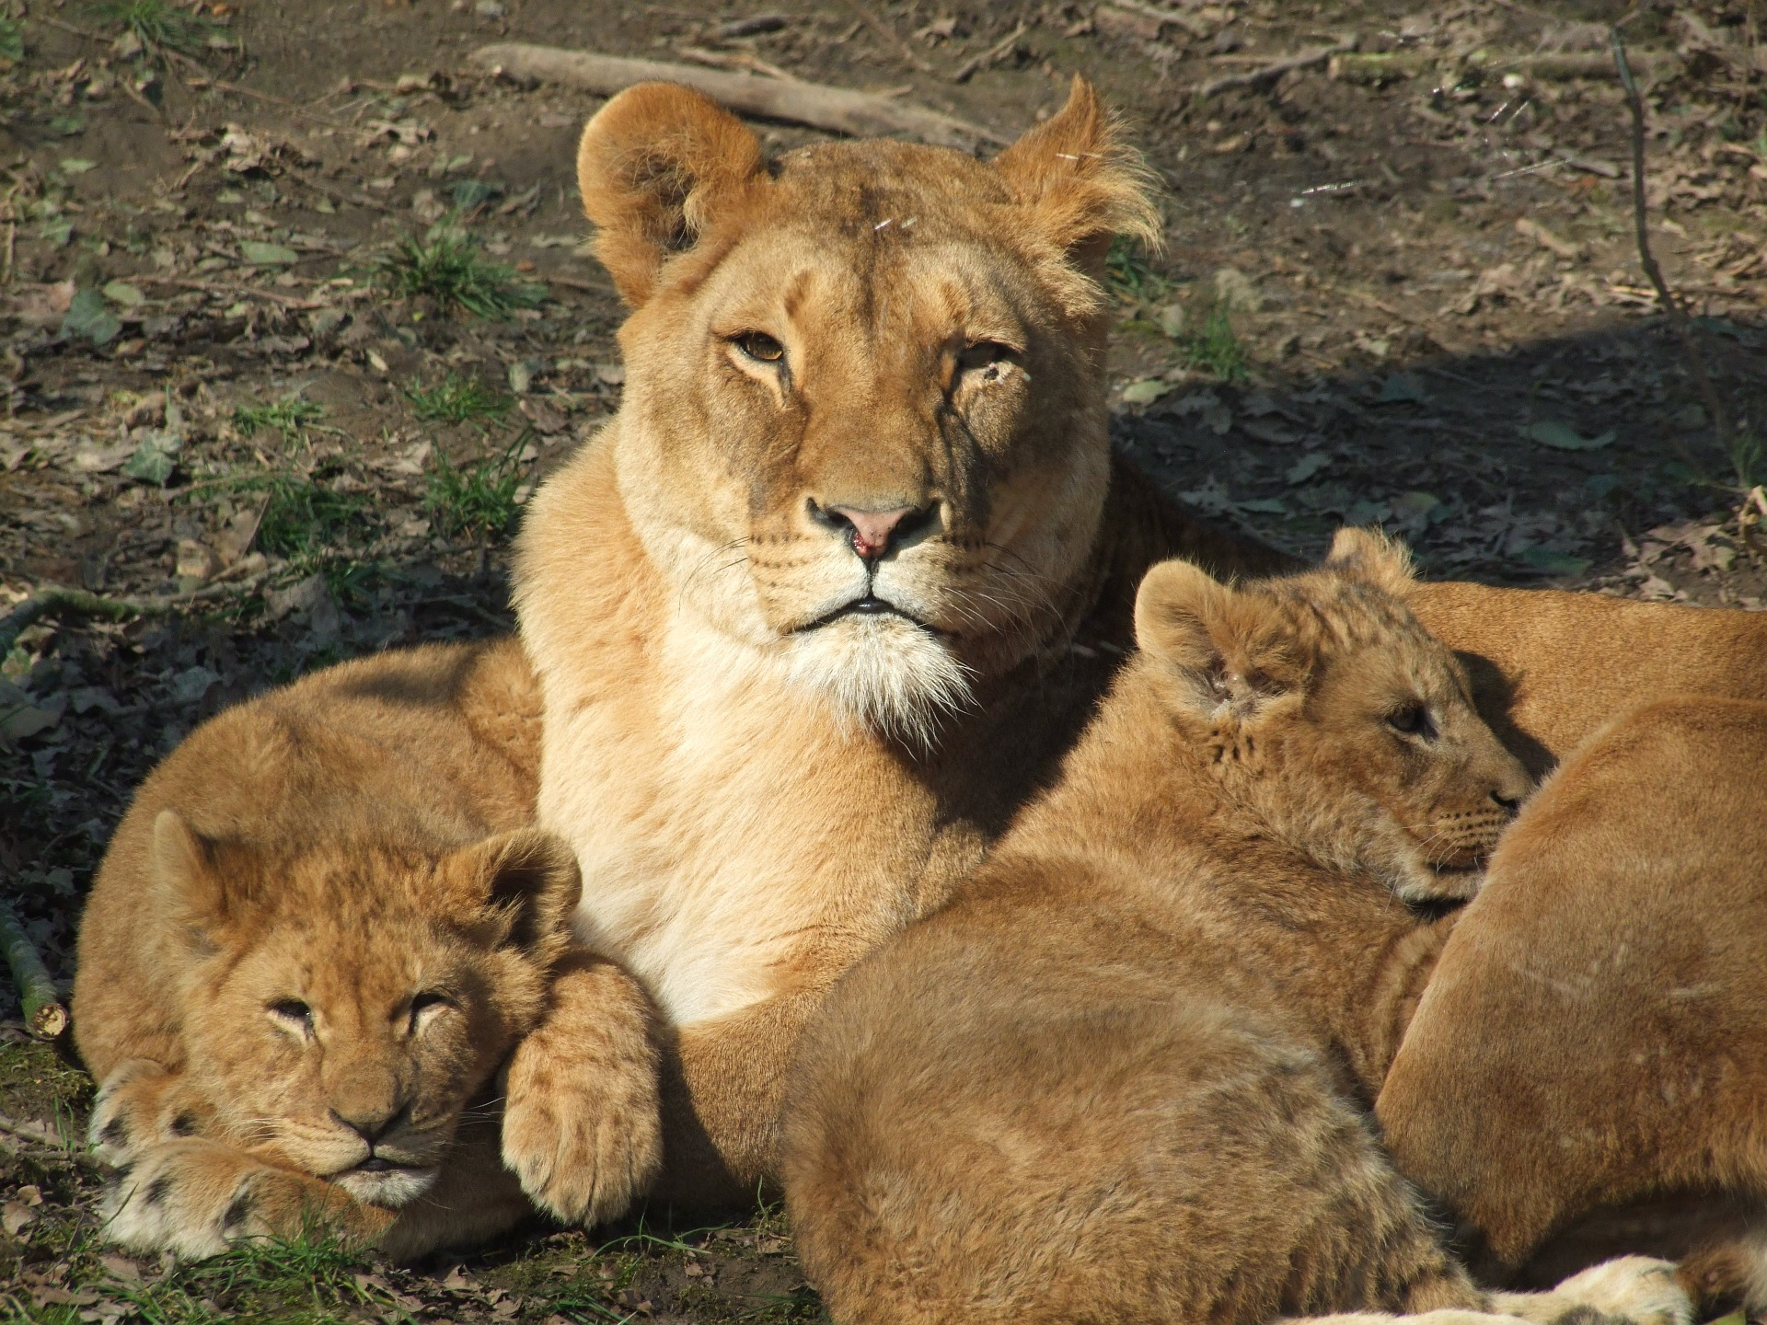
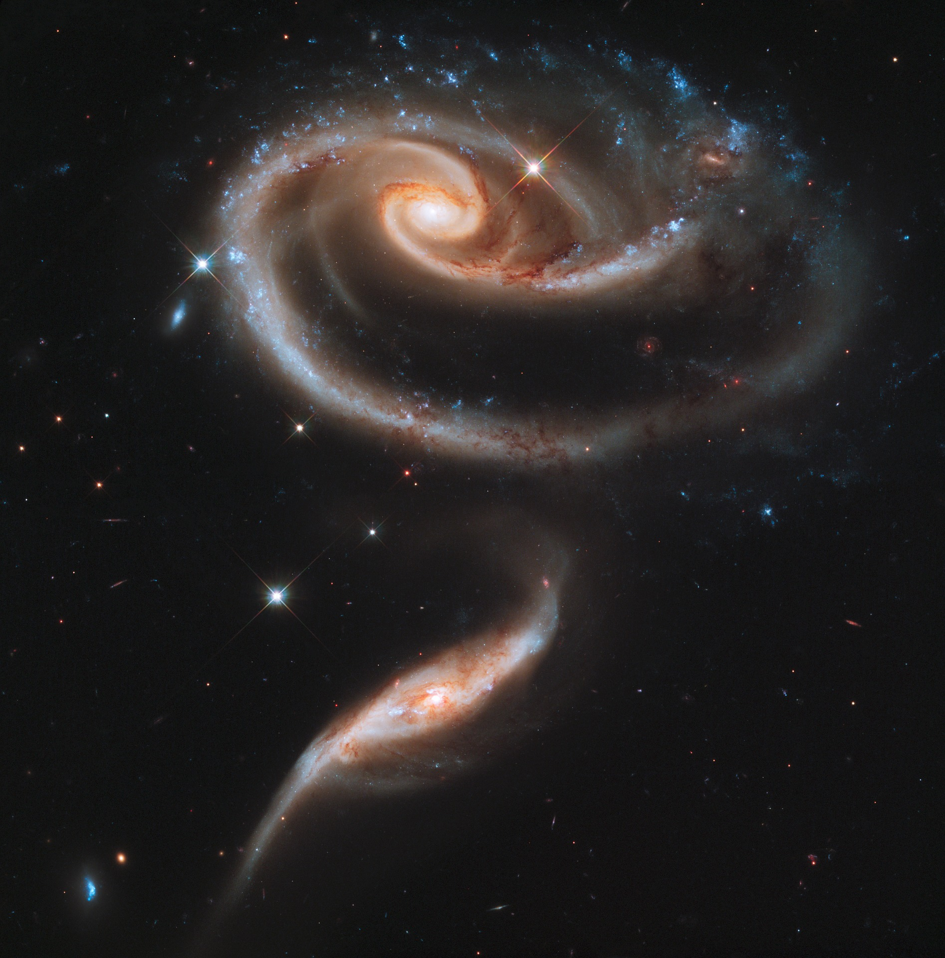
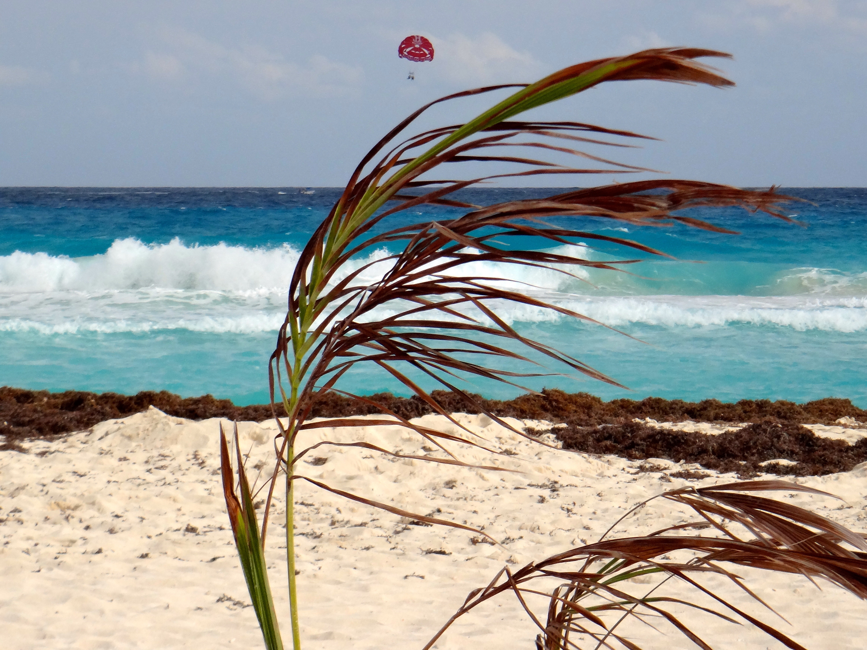
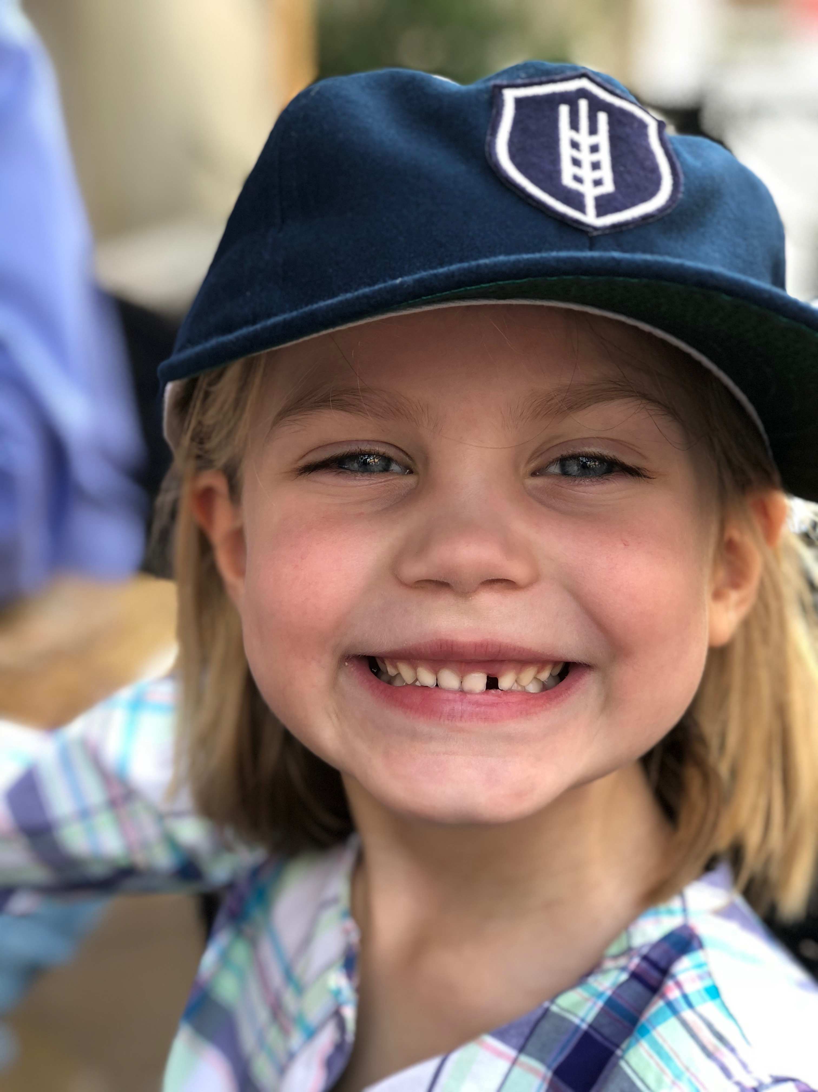
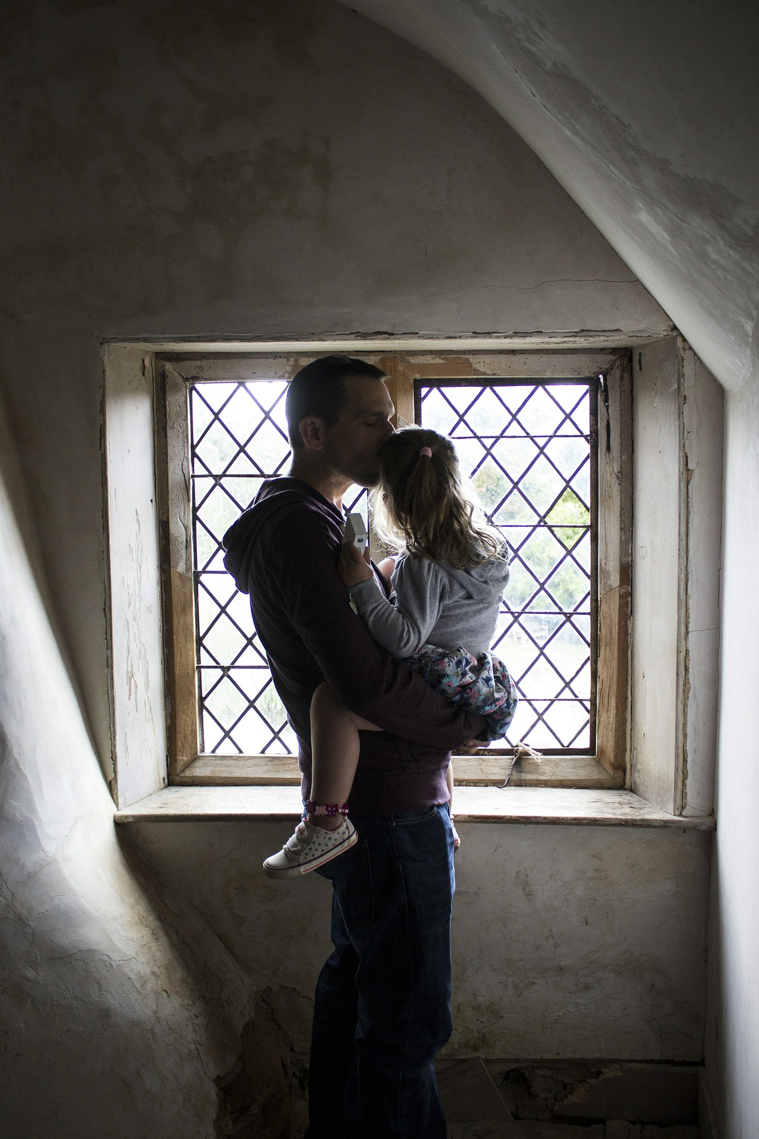
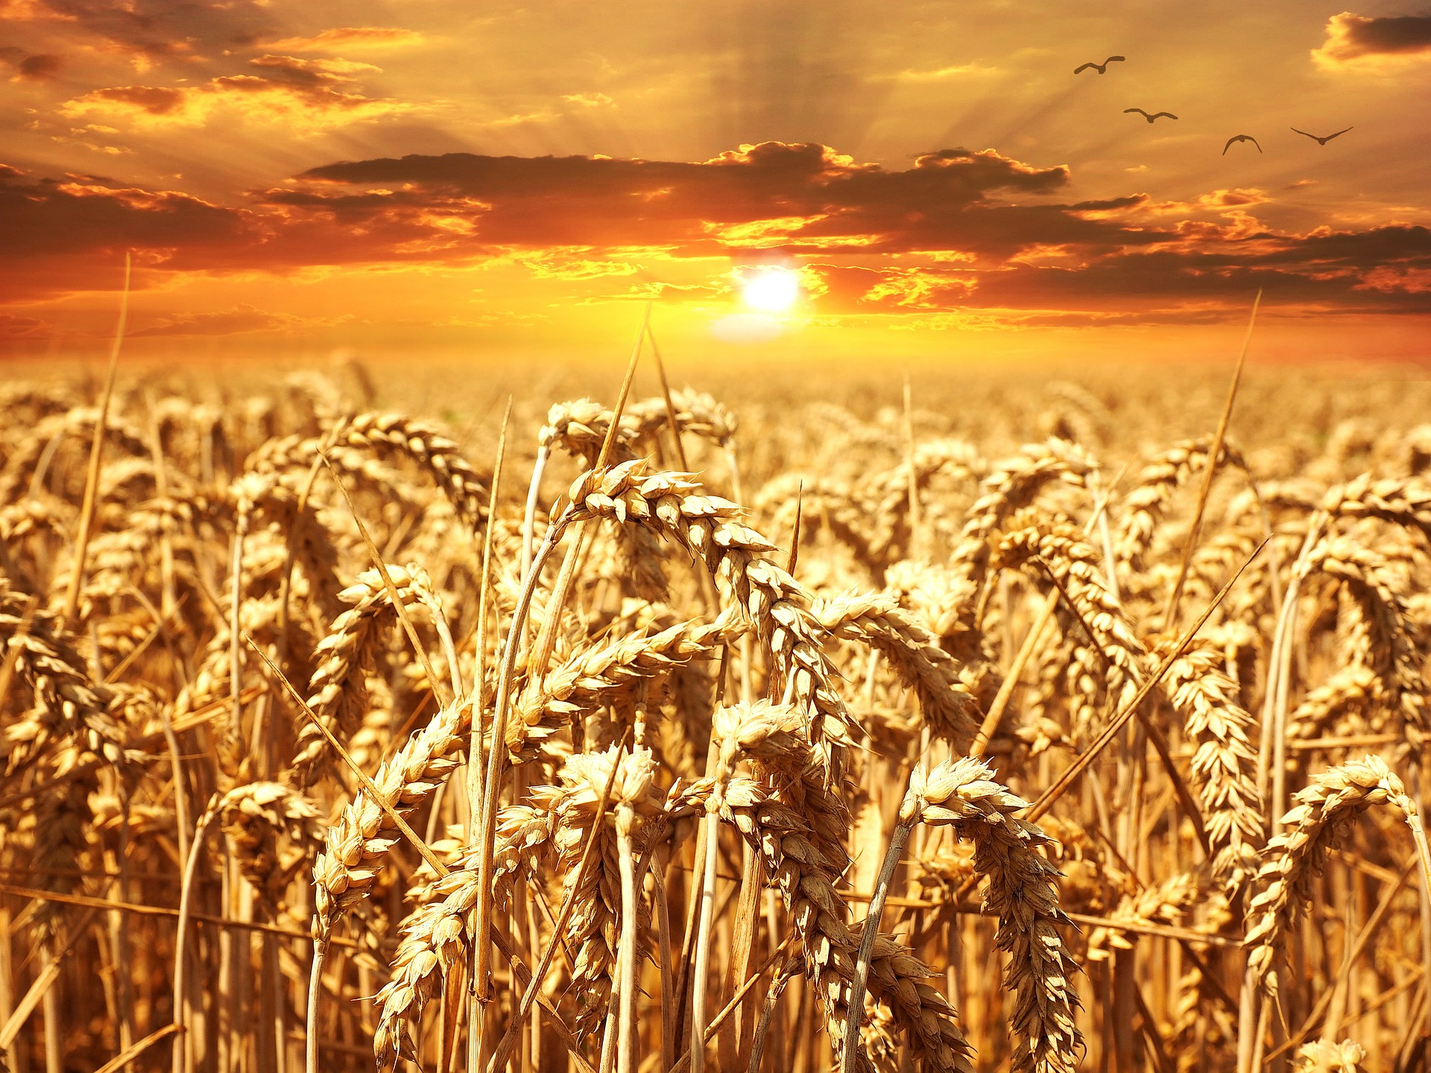
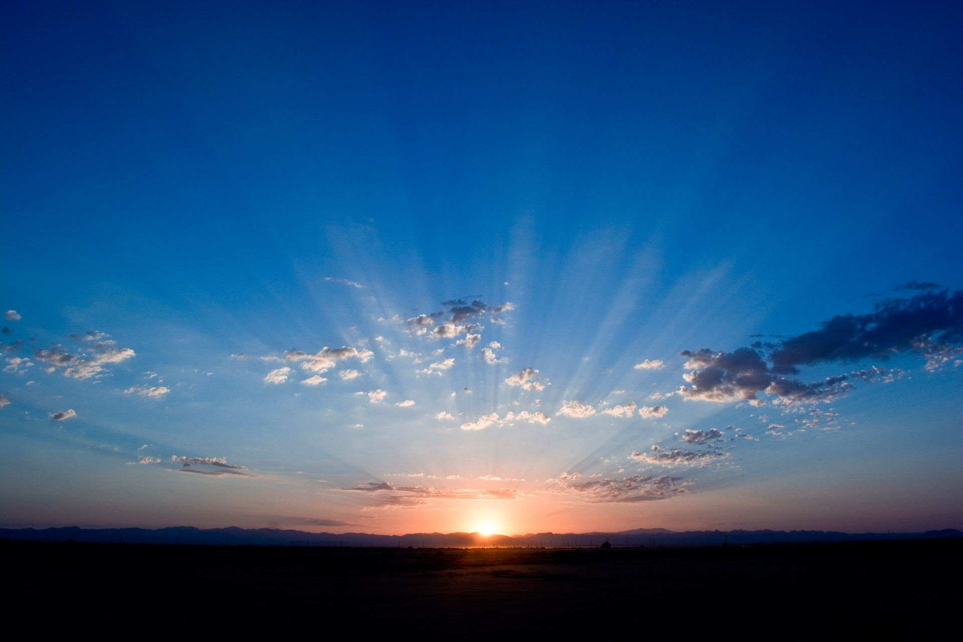
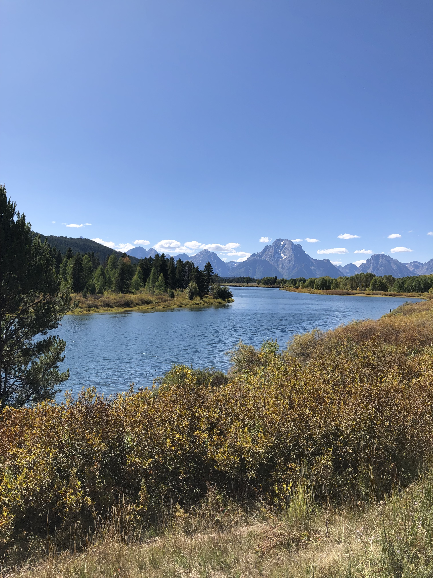
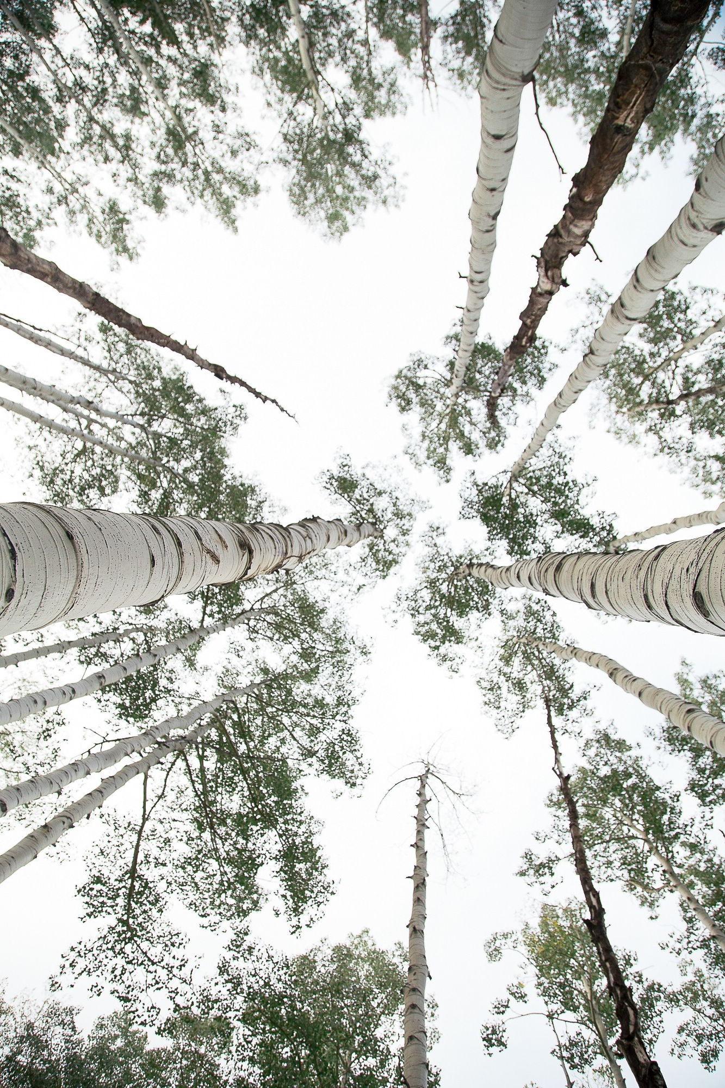

Slide 7
Genesis 1
In the beginning when God created the heavens and the earth, the earth was a formless void and darkness covered the face of the deep, while a wind from God swept over the face of the waters. Then God said, “Let there be light”; and there was light. And God saw that the light was good; and God separated the light from the darkness. God called the light Day, and the darkness he called Night. And there was evening and there was morning, the first day.
And God said, “Let there be a dome in the midst of the waters, and let it separate the waters from the waters.” So God made the dome and separated the waters that were under the dome from the waters that were above the dome. And it was so. God called the dome Sky. And there was evening and there was morning, the second day.
And God said, “Let the waters under the sky be gathered together into one place, and let the dry land appear.” And it was so. God called the dry land Earth, and the waters that were gathered together he called Seas. And God saw that it was good. Then God said, “Let the earth put forth vegetation: plants yielding seed, and fruit trees of every kind on earth that bear fruit with the seed in it.” And it was so. The earth brought forth vegetation: plants yielding seed of every kind, and trees of every kind bearing fruit with the seed in it. And God saw that it was good. And there was evening and there was morning, the third day.

Slide 8
Genesis 1
And God said, “Let there be lights in the dome of the sky to separate the day from the night; and let them be for signs and for seasons and for days and years, and let them be lights in the dome of the sky to give light upon the earth.” And it was so. God made the two great lights—the greater light to rule the day and the lesser light to rule the night—and the stars. God set them in the dome of the sky to give light upon the earth, to rule over the day and over the night, and to separate the light from the darkness. And God saw that it was good. And there was evening and there was morning, the fourth day

Slide 9
Genesis 1
N bv
So God created humankind^{[e]} in God’s image, in the image of God created them;^{[f]} male and female God created them.
God blessed them, and God said to them, “Be fruitful and multiply, and fill the earth and subdue it; and have dominion over the fish of the sea and over the birds of the air and over every living thing that moves upon the earth.” God said, “See, I have given you every plant yielding seed that is upon the face of all the earth, and every tree with seed in its fruit; you shall have them for food. And to every beast of the earth, and to every bird of the air, and to everything that creeps on the earth, everything that has the breath of life, I have given every green plant for food.” And it was so. God saw everything that he had made, and indeed, it was very good. And there was evening and there was morning, the sixth day.

Slide 10
QUESTIONS
Each participant choose one of the following questions to answer.
Consider the Genesis 1 passage. What stands out to you about God?
How do you experience God as “creator” for all things “good”?
How might “good” and “thriving” fit together?
All Answer: How might your image and this passage connect?
Choose ANOTHER IMAGE
Look through the images and select whichever one “speaks” to or “resonates” with you about your place in creation.

Slide 12
GATHER IDEAS
Tell us about your image. What stands out to you? Why did you choose it?
What does “created in the image of God” say to you about what God has in mind for God’s world?
IMAGE COLLAGE
Gather the images that your team chose together—either physically or take screenshots or pics. After all images are gathered, take a moment to look at the collages of images.
What stands out to you? What are you drawn to?
What does this collage tell us about God and thriving?
Where do we experience this kind of thriving as a church—for our world?
Save your collage and your notes on your responses to the last three questions.

Slide 13
A Well-Watered Garden
Isaiah 58

Slide 14
BEGIN
STEP 1: TAKE TIME TO PRAY
Praise God for God’s presence among us.
Ask God for wisdom in understanding what it means to thrive as a congregation and the courage to live into God’s grace in our current local, national and global context.
STEP 2: Read the Isaiah 58 passage together
STEP 3: Look through the images and select whichever one “speaks to or “resonates with what your heard in the passage
STEP 4: UNPACK IMAGES
Take time for each person to share their picture.
What feelings and thoughts surface within you when you look at your image?
What story does your image tell about GOD?
How does this image connect with your life story?
What does this story tell us about how God desires for his people to thrive?

Slide 15
Isaiah 58: 8-12
Then your light shall break forth like the dawn, and your healing shall spring up quickly; your vindicator[ shall go before you, the glory of the Lord shall be your rear guard. Then you shall call, and the Lord will answer; you shall cry for help, and he will say, Here I am.
If you remove the yoke from among you, the pointing of the finger, the speaking of evil, if you offer your food to the hungry and satisfy the needs of the afflicted, then your light shall rise in the darkness and your gloom be like the noonday. The Lord will guide you continually, and satisfy your needs in parched places, and make your bones strong; and you shall be like a watered garden, like a spring of water, whose waters never fail. Your ancient ruins shall be rebuilt; you shall raise up the foundations of many generations; you shall be called the repairer of the breach, the restorer of streets to live in.

Slide 16
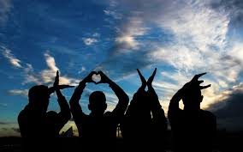
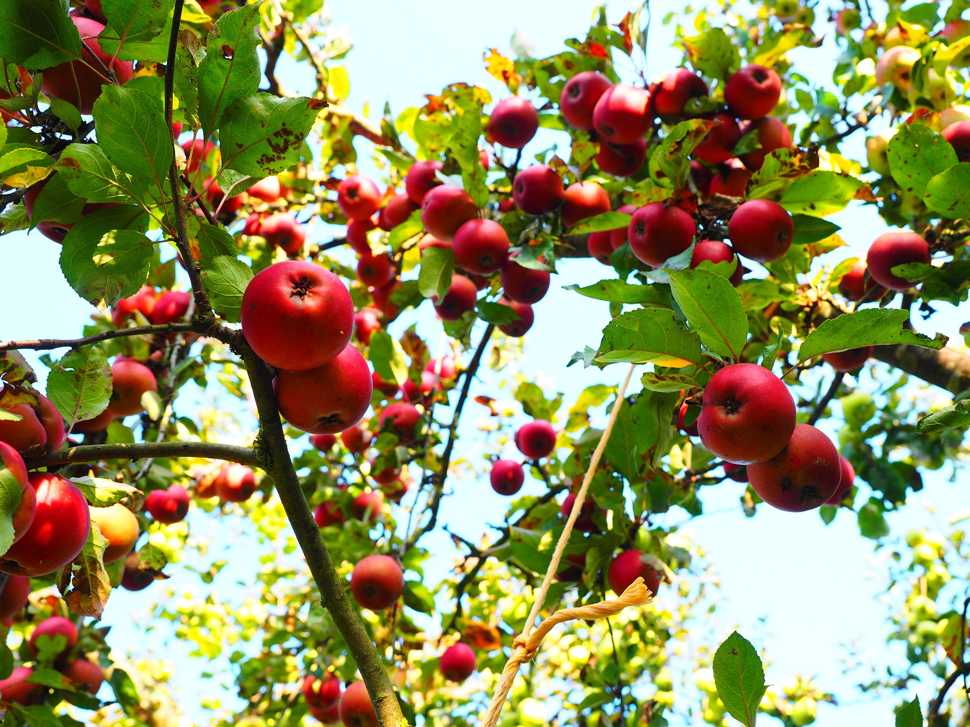
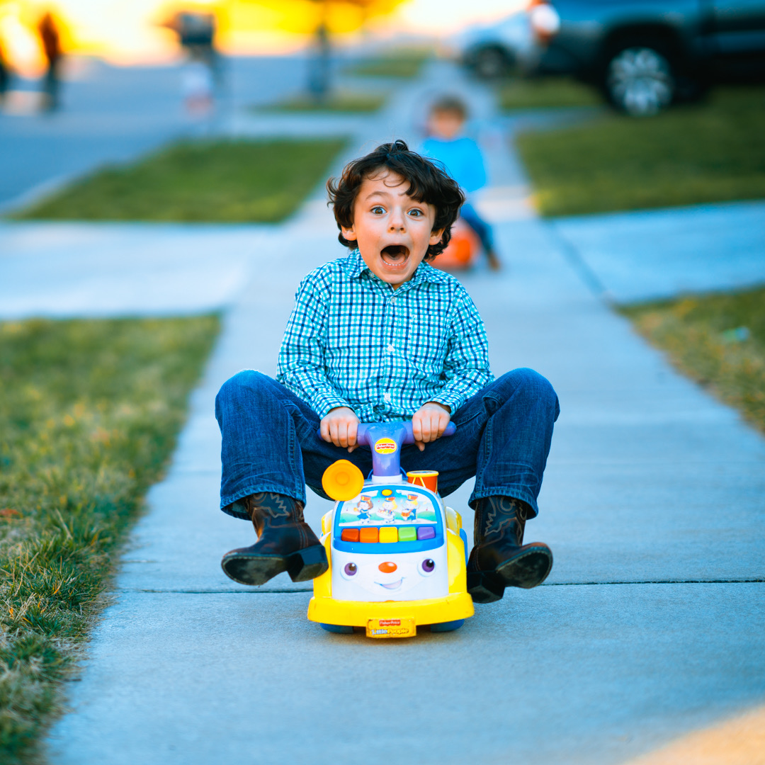
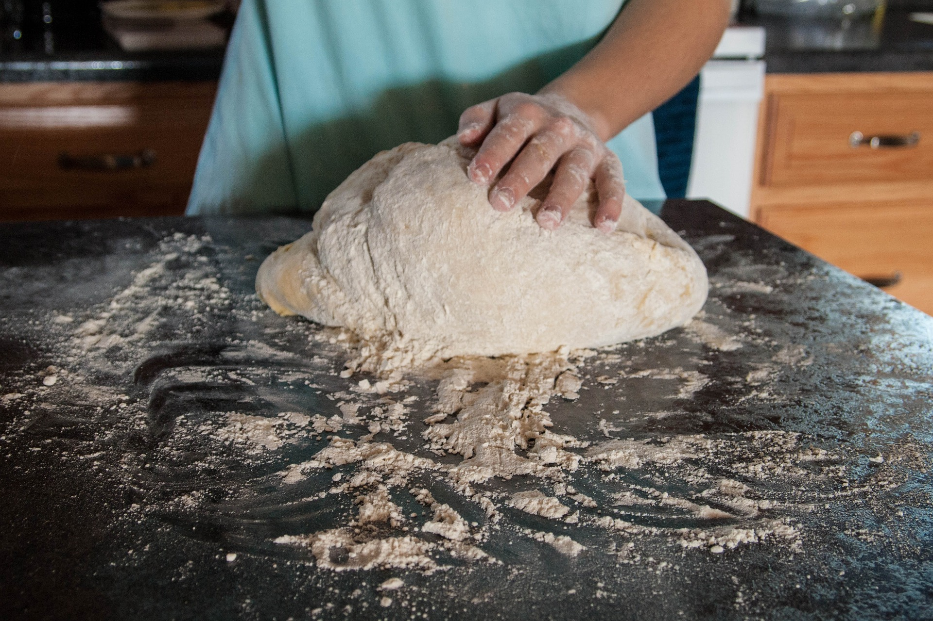
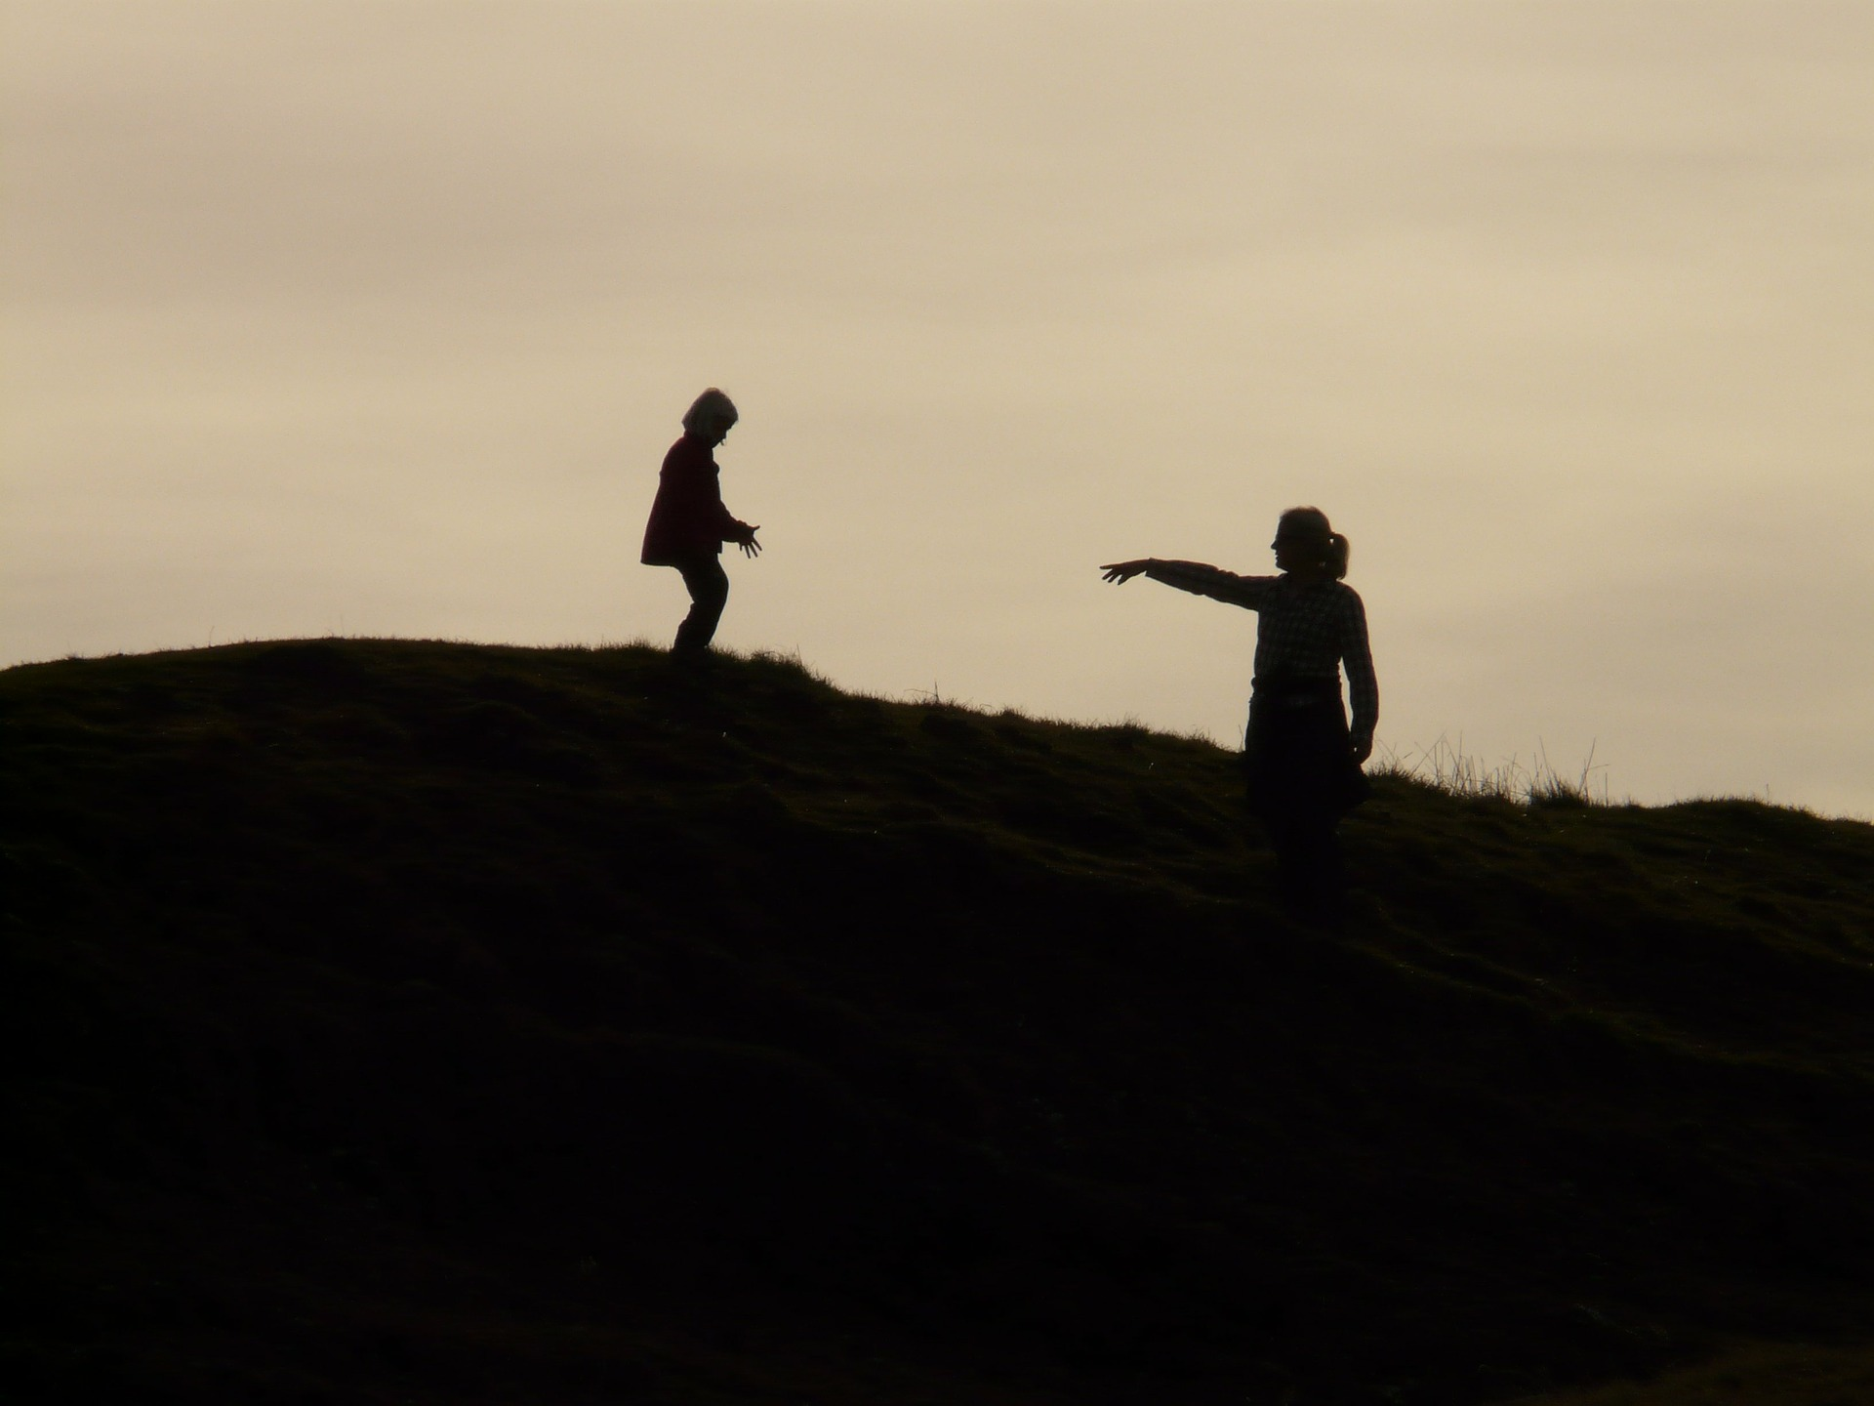
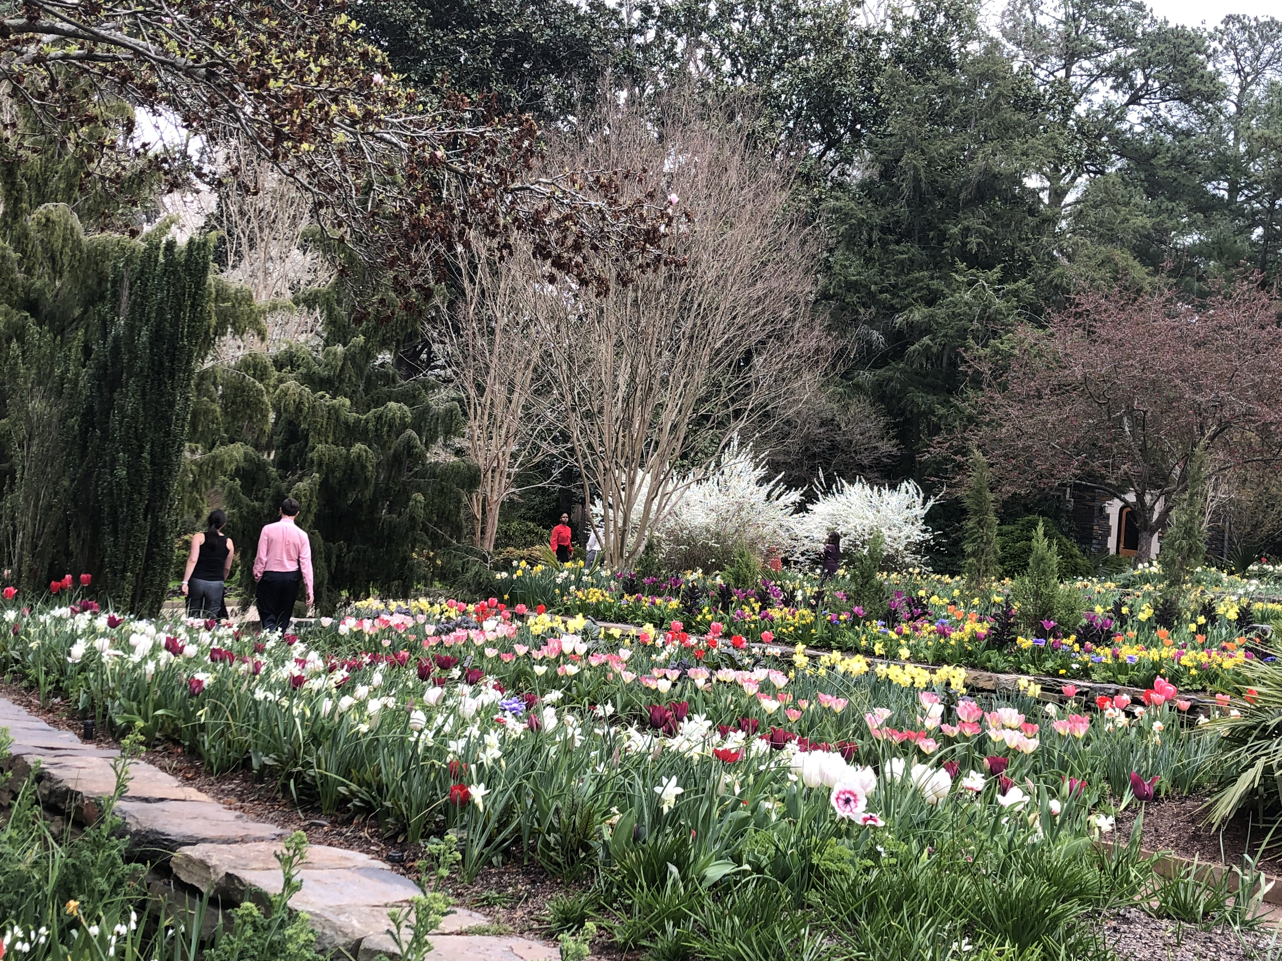

Slide 17
GATHER IDEAS
Gather the images that your team chose together—either physically or take screenshots or pics. After all images are gathered, take a moment to look at the collages of images.
Below each image, write a one to three-word description of each image.
What stands out to you? What are you drawn to?
What does this collage tell us about God and thriving?
Are there other images that you want to add to this picture of thriving? Google and share them.
What might these collages tell us about life in our church? In our community?
Where do we experience this kind of thriving as a church—for our world?
Save your collage and your notes on your responses to the last three questions.

Slide 18
Do Not Worry
Matthew 6

Slide 19
BEGIN
TAKE TIME TO PRAY
Thank God for God’s presence among us.
Ask God for wisdom in understanding what it means to thrive as a congregation and the courage to live into God’s grace in the world you created-- local, nationally and globally.
PICK AN IMAGE
Look through the images and select whichever one “speaks” to or “resonates” with you
about a fear.
UNPACK IMAGES
Take time for each person to share their picture.
What drew you to your image?
What’s the story of your image?
How do your images reflect your thoughts about your church?
Read Matthew 6 together

Slide 20
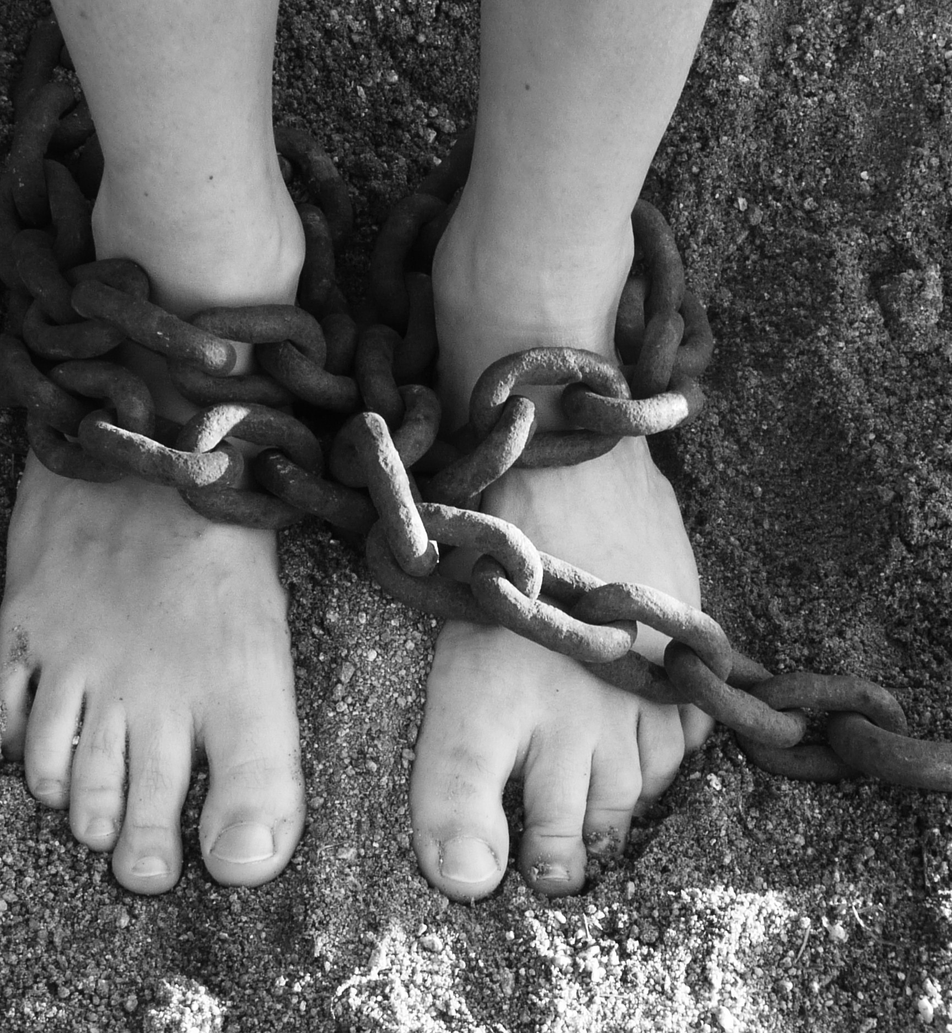
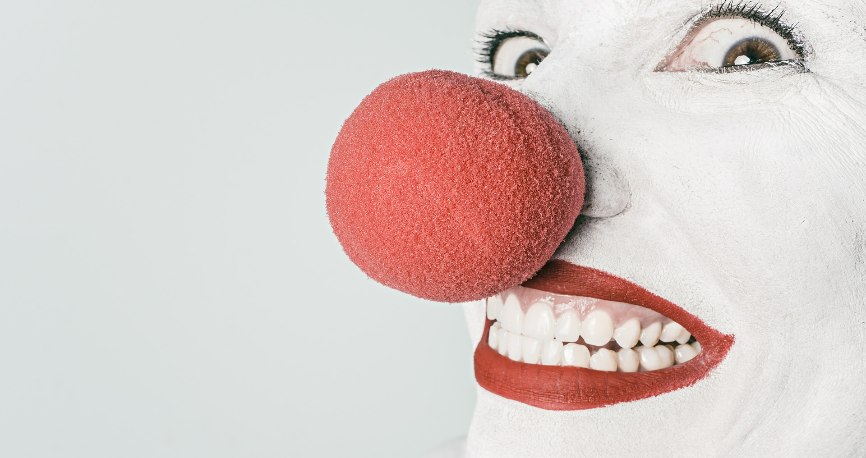

Slide 21
Matthew 6: 25-33
“Therefore I tell you, do not worry about your life, what you will eat or what you will drink, or about your body, what you will wear. Is not life more than food, and the body more than clothing? Look at the birds of the air; they neither sow nor reap nor gather into barns, and yet your heavenly Father feeds them. Are you not of more value than they? And can any of you by worrying add a single hour to your span of life? And why do you worry about clothing? Consider the lilies of the field, how they grow; they neither toil nor spin, yet I tell you, even Solomon in all his glory was not clothed like one of these. But if God so clothes the grass of the field, which is alive today and tomorrow is thrown into the oven, will he not much more clothe you—you of little faith? Therefore do not worry, saying, ‘What will we eat?’ or ‘What will we drink?’ or ‘What will we wear?’ For it is the Gentiles who strive for all these things; and indeed your heavenly Father knows that you need all these things. But strive first for the kingdom of God and God’s righteousness, and all these things will be given to you as well.
25 “Therefore I tell you, do not worry about your life, what you will eat or what you will drink,[j] or about your body, what you will wear. Is not life more than food, and the body more than clothing? 26 Look at the birds of the air; they neither sow nor reap nor gather into barns, and yet your heavenly Father feeds them. Are you not of more value than they? 27 And can any of you by worrying add a single hour to your span of life?[k] 28 And why do you worry about clothing? Consider the lilies of the field, how they grow; they neither toil nor spin, 29 yet I tell you, even Solomon in all his glory was not clothed like one of these. 30 But if God so clothes the grass of the field, which is alive today and tomorrow is thrown into the oven, will he not much more clothe you—you of little faith? 31 Therefore do not worry, saying, ‘What will we eat?’ or ‘What will we drink?’ or ‘What will we wear?’ 32 For it is the Gentiles who strive forall these things; and indeed your heavenly Father knows that you need all these things. But strive first for the kingdom of God[l] and his[m] righteousness, and all these things will be given to you as well.

Slide 22
QUESTIONS
What does Jesus have to say about your fears?
What picture of ”thriving” do you get in this passage?
What makes you uncomfortable about this passage?
Look at the next set of images. Choose one that reflects this passage to you?

Slide 23
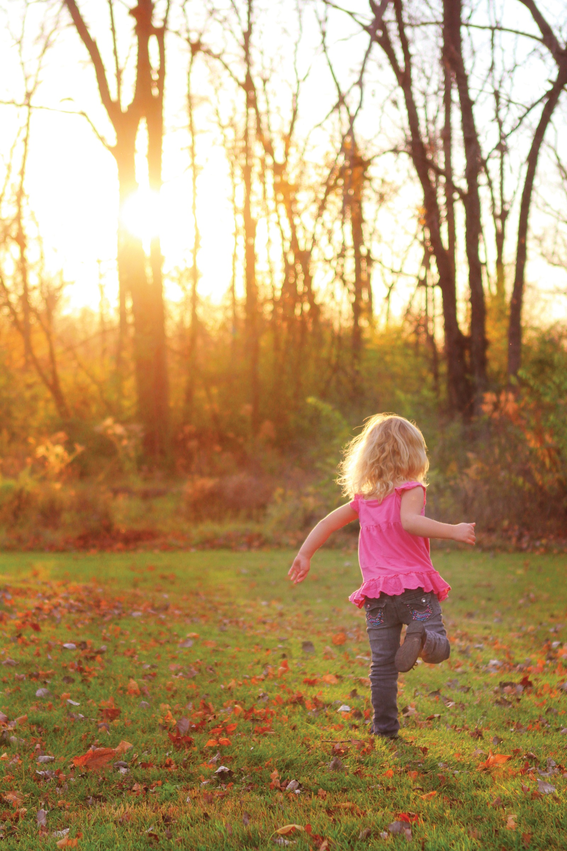
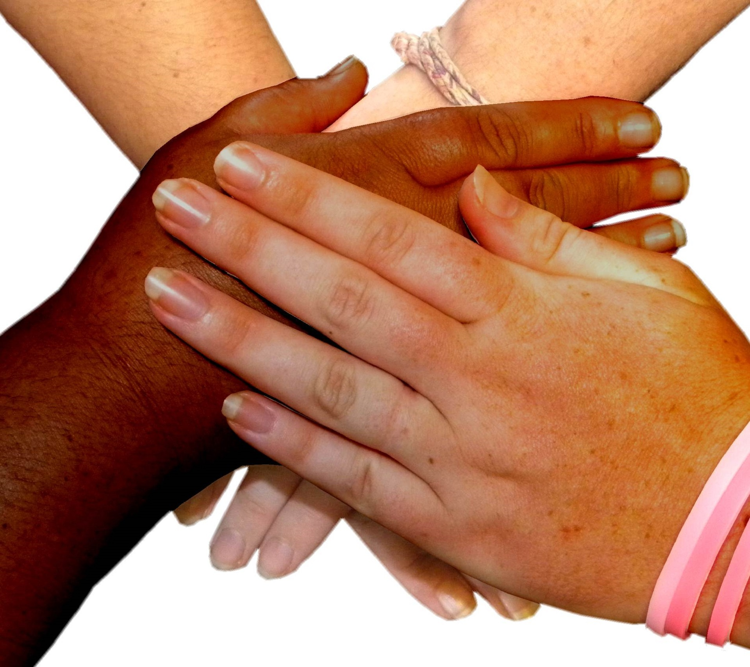
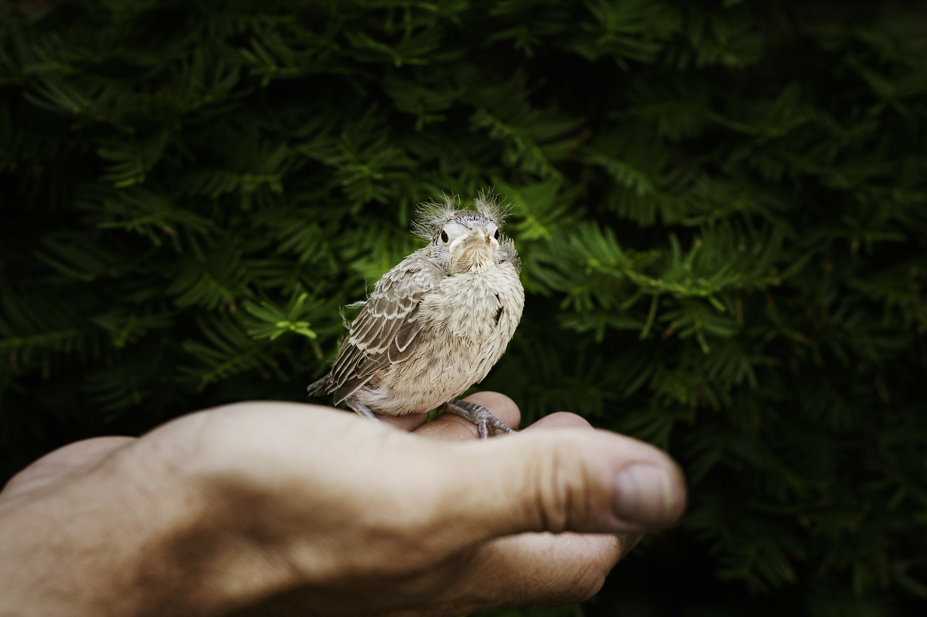
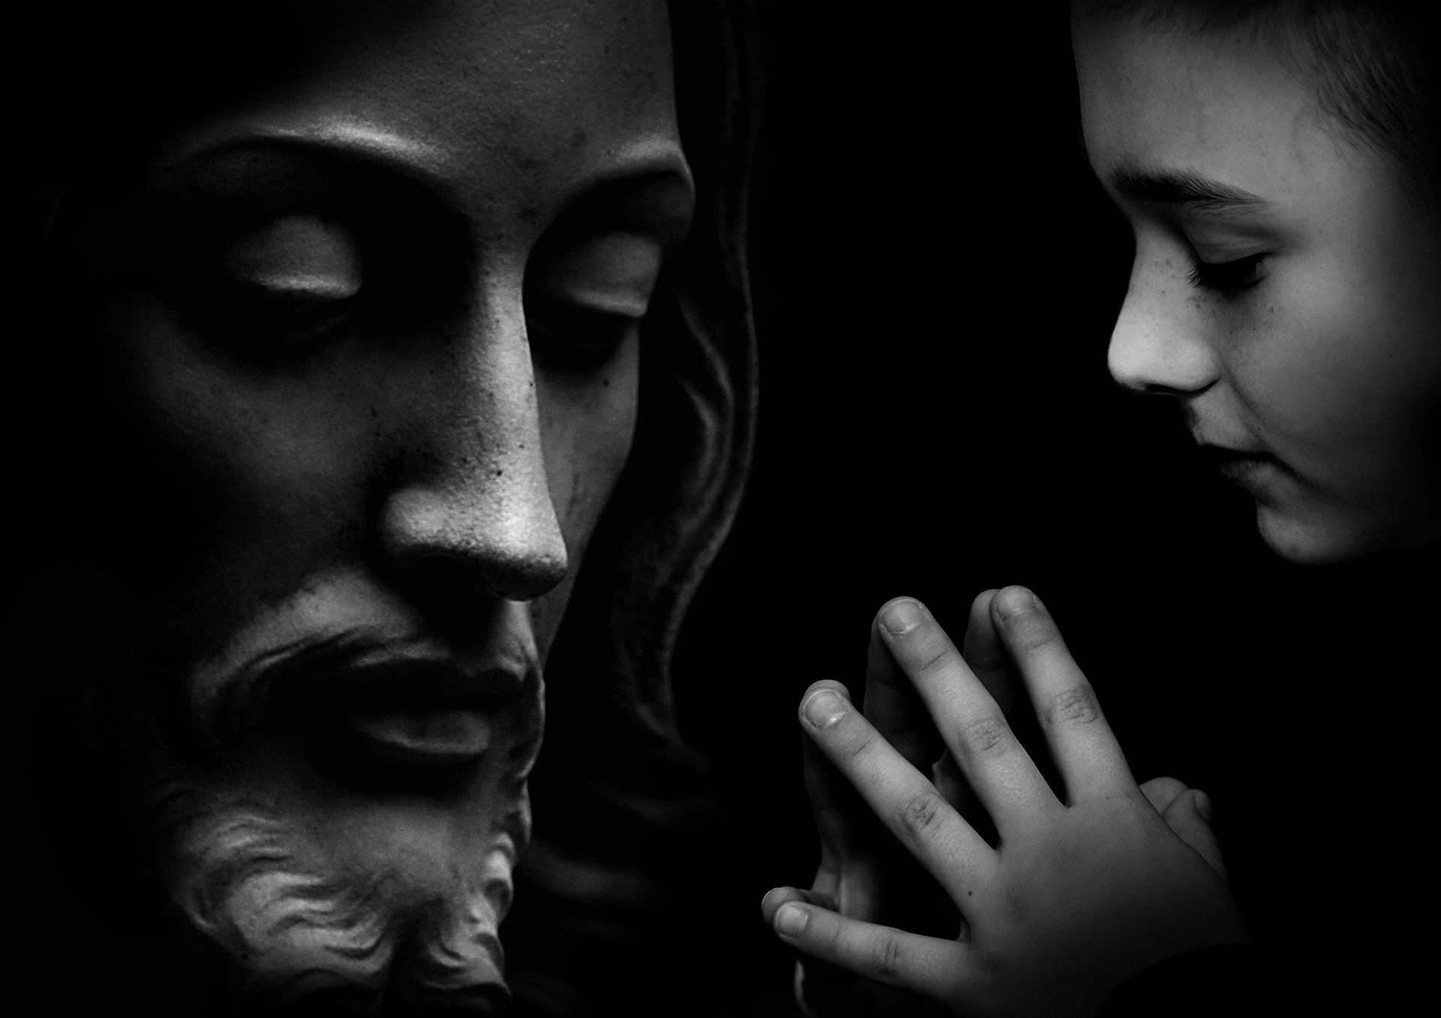

Slide 24
GATHER IDEAS
Gather the images that your team chose together—either physically or take screenshots or pics. After all images are gathered, take a moment to look at the collages of images.
What stands out to you? What are you drawn to?
What does this collage tell us about God and thriving?
What might these collages tell us about life in our church? In our community?
Where do we experience this kind of thriving as a church—for our world?
Save your collage and your notes on your responses to the last three questions.

Slide 25
Community
Acts 2

Slide 26
BEGIN
TAKE TIME TO PRAY
Thank God for God’s presence among us.
Ask God for wisdom in understanding what it means to thrive as a congregation and the courage to live into God’s grace in the world you created-- local, nationally and globally.
PICK AN IMAGE
Look through the images and select whichever one “speaks” to or “resonates” with you about “community”.
UNPACK IMAGES
Take time for each person to share their picture.
What excites you about your image?
What’s the story of your image?
What does your image say about the church?

Slide 27
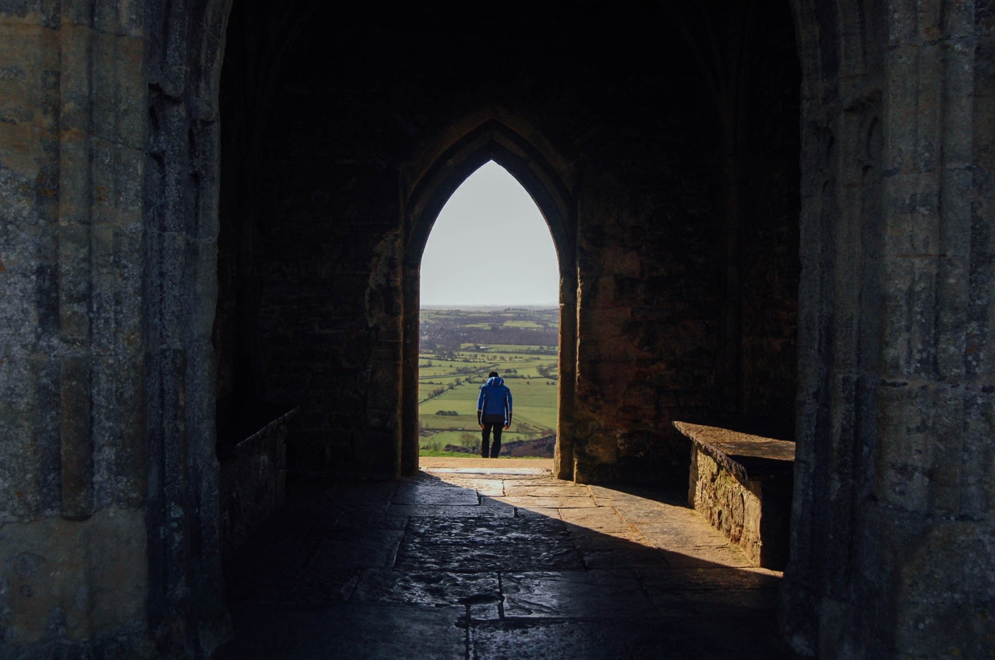
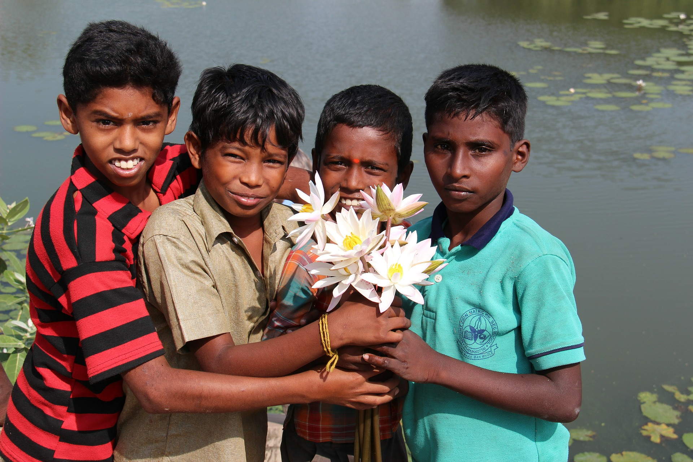
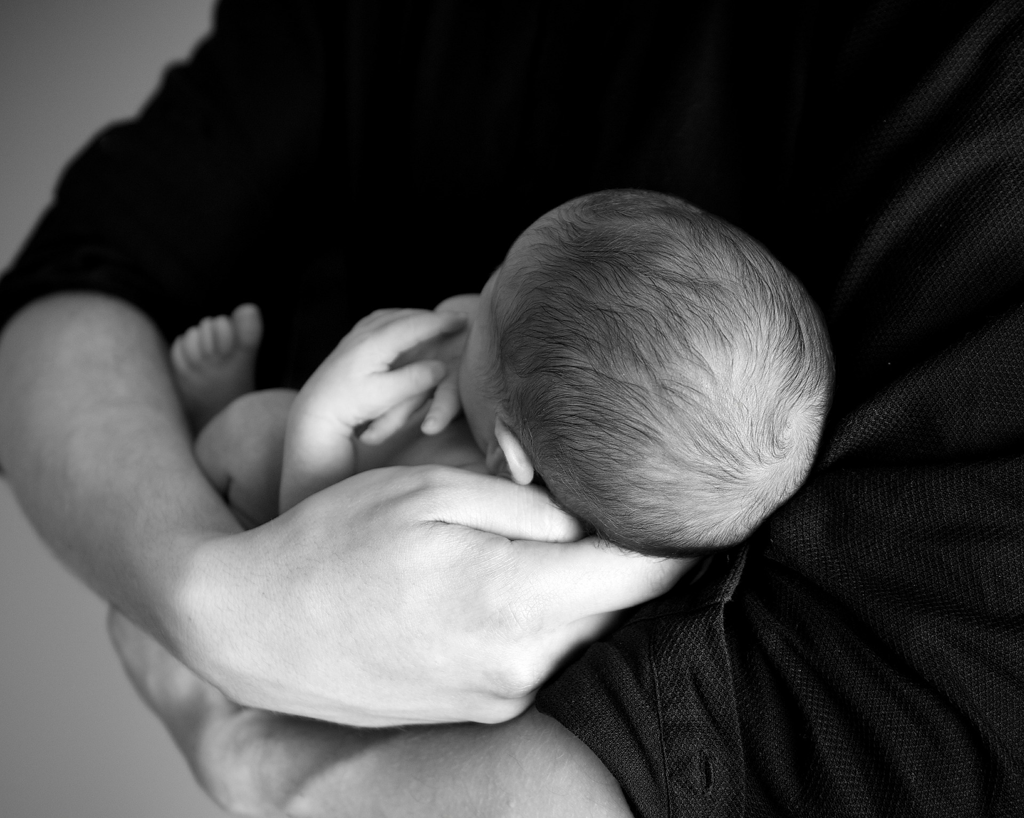
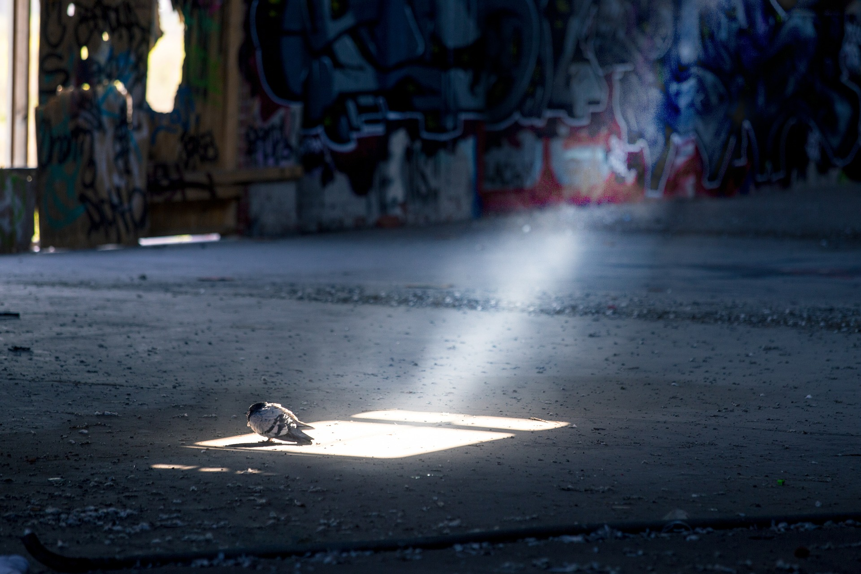
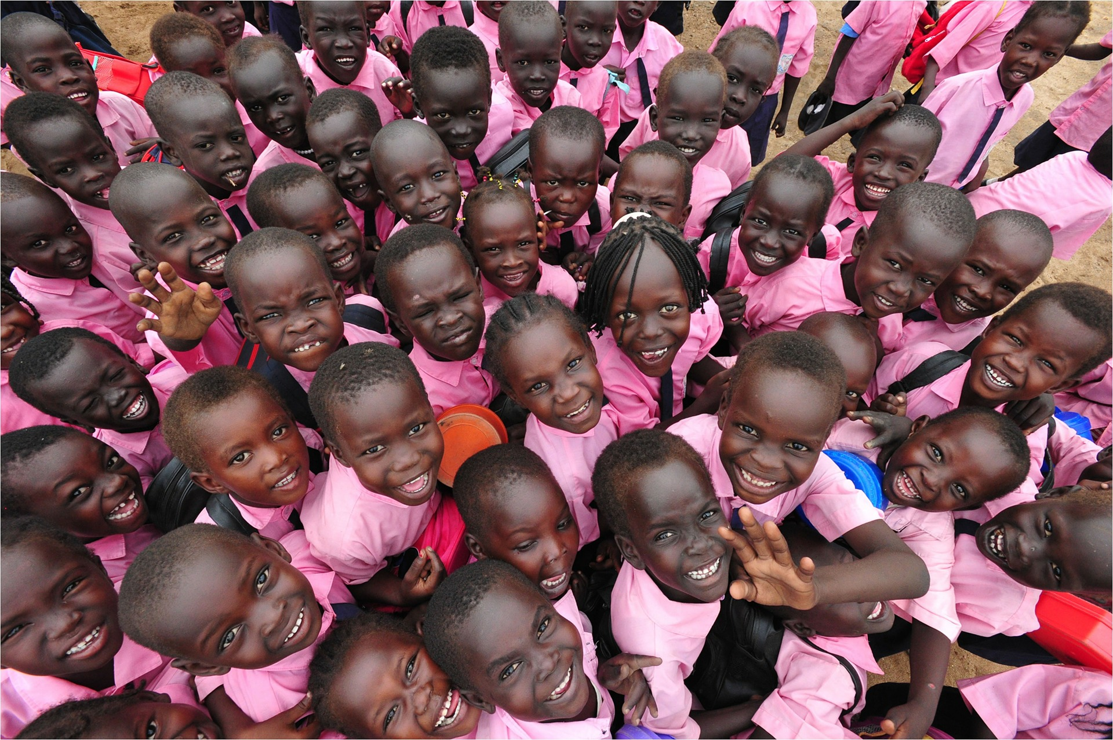
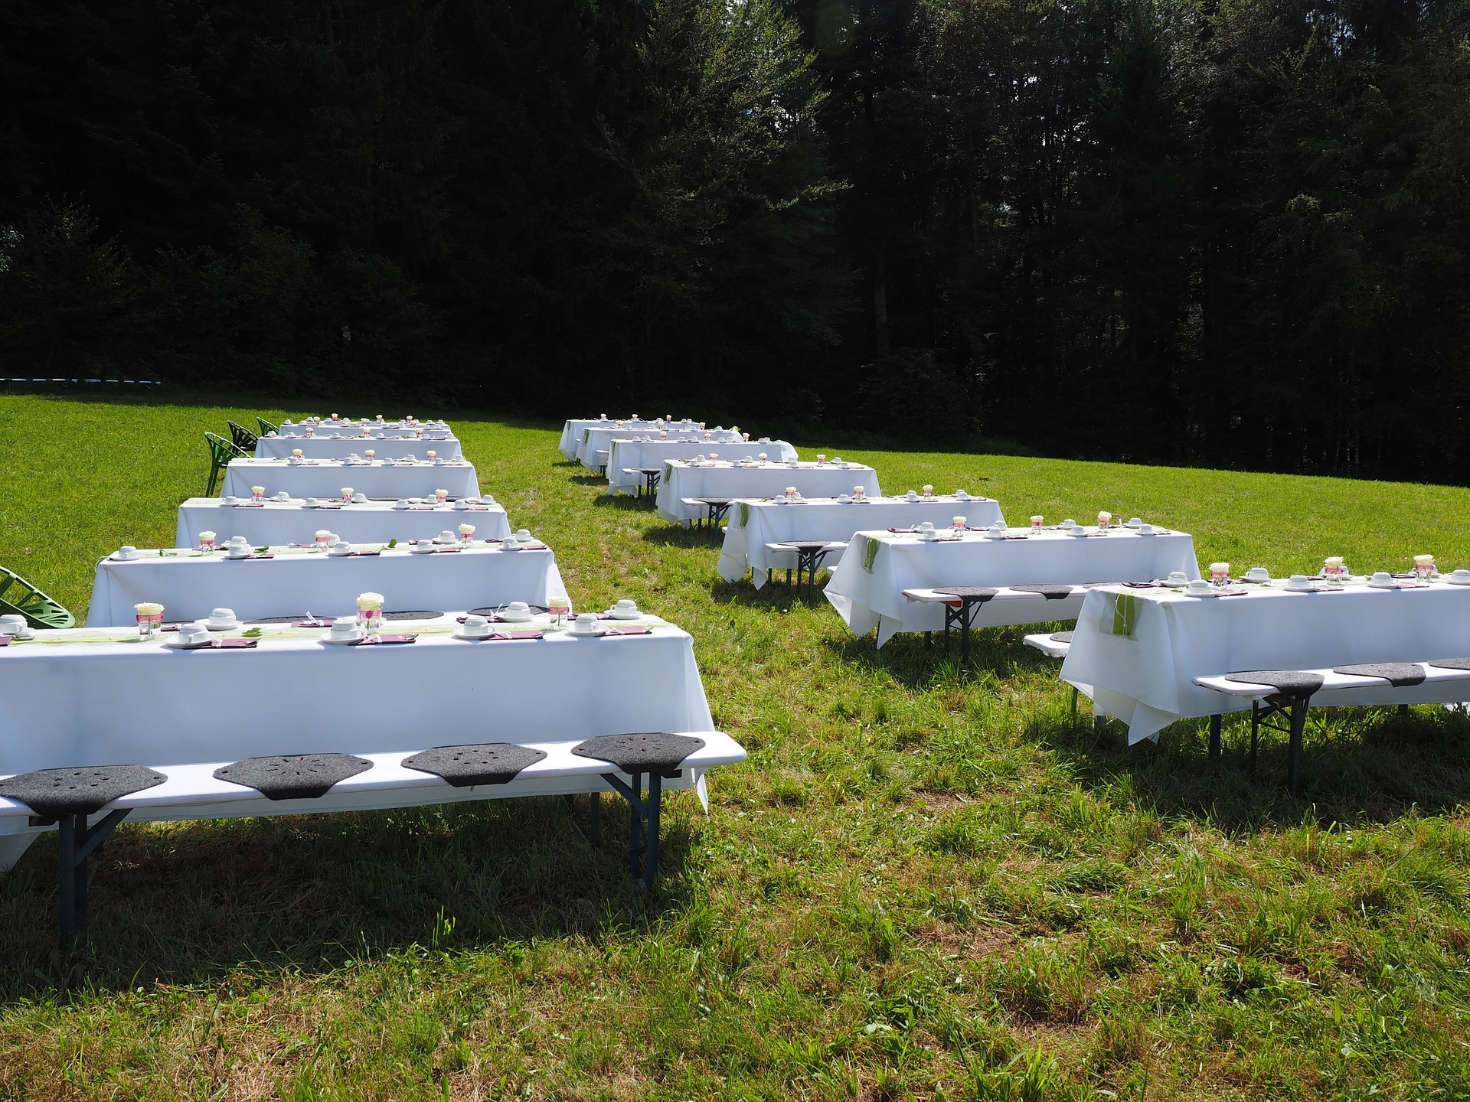

Slide 28
Acts 2: 39-47
Peter said to them, “Repent, and be baptized every one of you in the name of Jesus Christ so that your sins may be forgiven; and you will receive the gift of the Holy Spirit. For the promise is for you, for your children, and for all who are far away, everyone whom the Lord our God calls to him.” And he testified with many other arguments and exhorted them, saying, “Save yourselves from this corrupt generation.” So those who welcomed his message were baptized, and that day about three thousand persons were added. They devoted themselves to the apostles’ teaching and fellowship, to the breaking of bread and the prayers.
Awe came upon everyone, because many wonders and signs were being done by the apostles. All who believed were together and had all things in common; they would sell their possessions and goods and distribute the proceeds to all, as any had need. Day by day, as they spent much time together in the temple, they broke bread at home and ate their food with glad and generous hearts, praising God and having the goodwill of all the people. And day by day the Lord added to their number those who were being saved.

Slide 29
QUESTIONS
REFLECT ON SCRIPTURE
How did the early church respond to needs
What beliefs about Jesus fortified their them?
Besides beliefs, are there other keys to their sense of community?
If you could add one thing to your image to make it even better, what would it be?

Slide 30
GATHER IDEAS
Gather the images that your team chose together—either physically or take screenshots or pics. After all images are gathered, take a moment to look at the collages of images.
Are there additional images about Christian community that you want to add?
Write down how these images reflect community of YOUR church? Be specific.
What does this collage tell us about God and thriving?
Where do we experience this kind of thriving as a church—for our world?
Save your collage and your notes on your responses to the last three questions.

Slide 31
THRIVING
REVELATION 20

Slide 32
BEGIN
TAKE TIME TO PRAY
Thank God for God’s presence among us.
Ask God for wisdom in understanding what it means to thrive as a congregation and the courage to live into God’s grace in the world you created-- local, nationally and globally.
PICK AN IMAGE
Look through the images and select whichever one “speaks” to or “resonates” with you about what PARADISE looks like for you
UNPACK IMAGES Take time for each person to share their picture.
What drew you to your image?
What’s the story of your image?
What does your image say about your thriving?
Read Revelation 21 together.

Slide 33
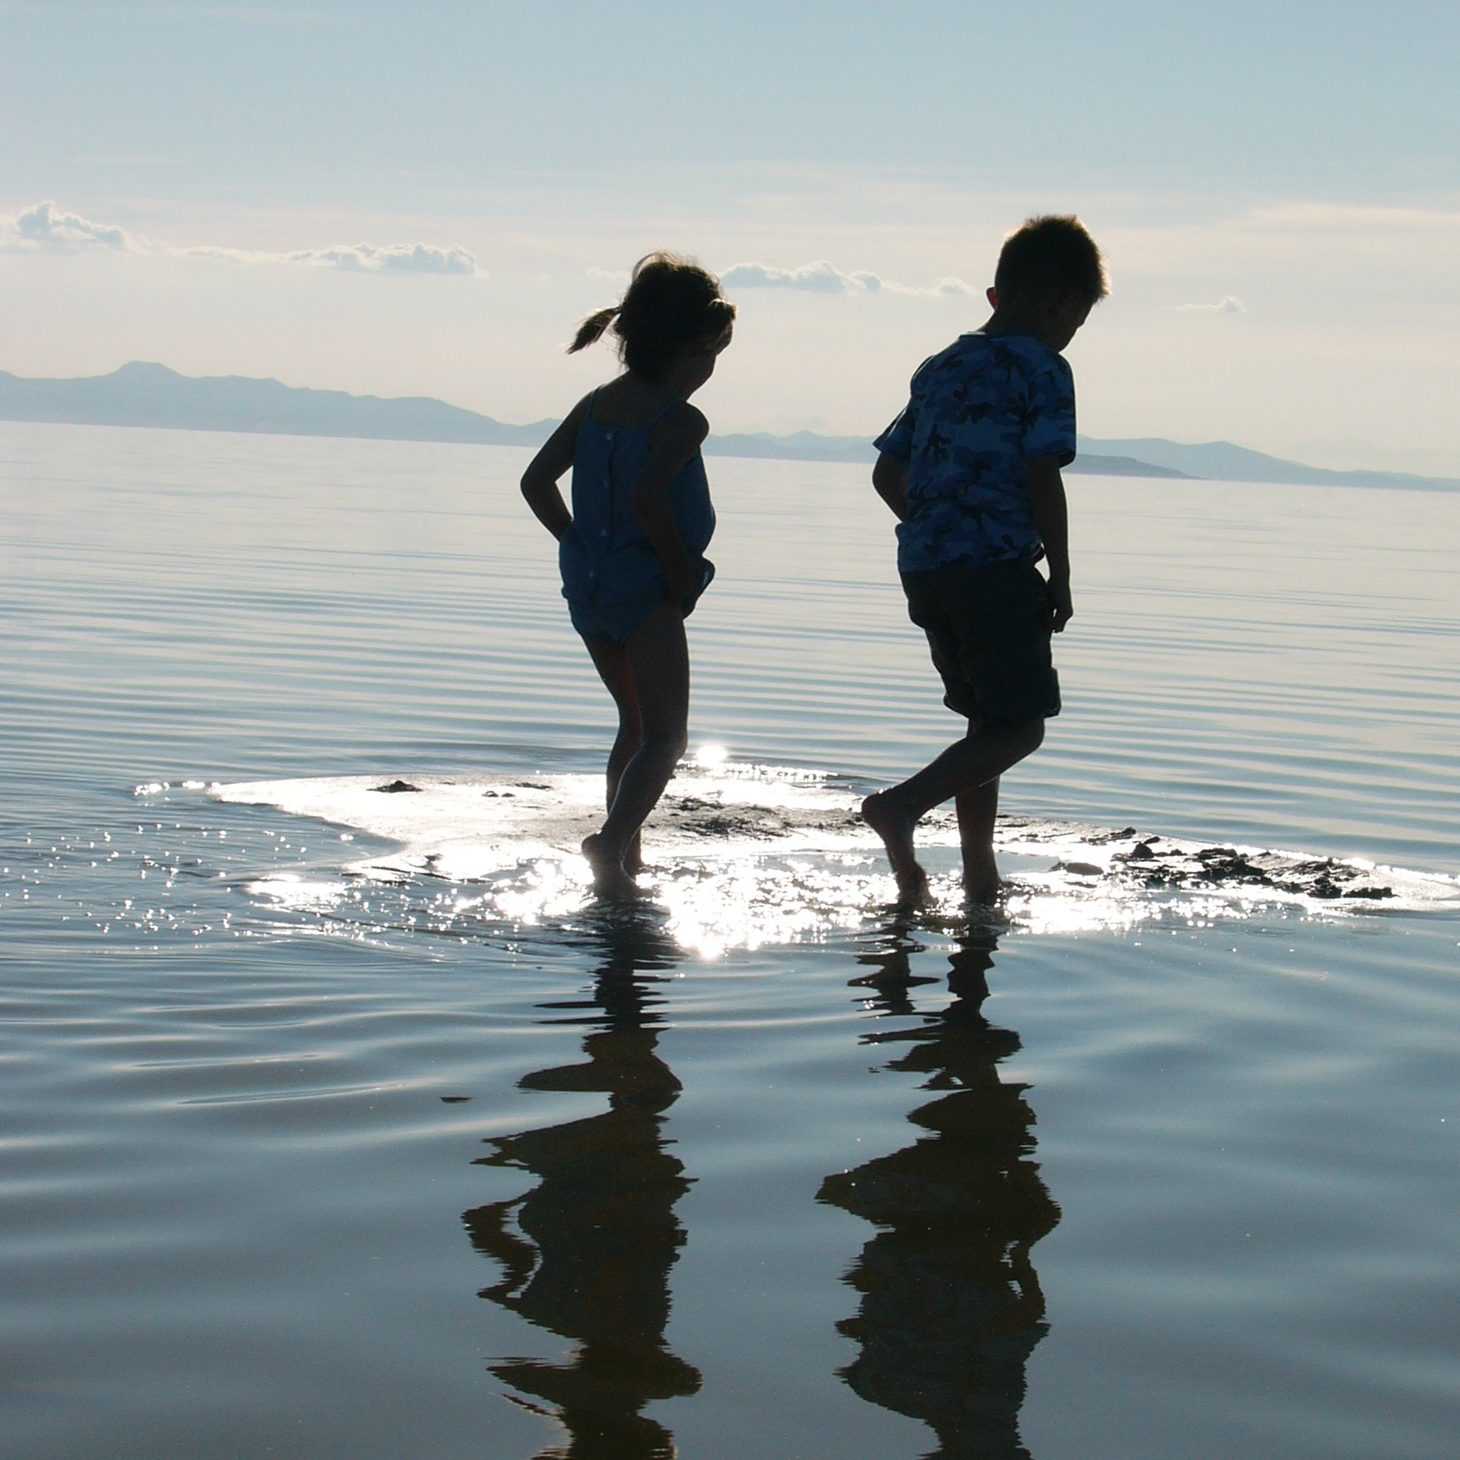
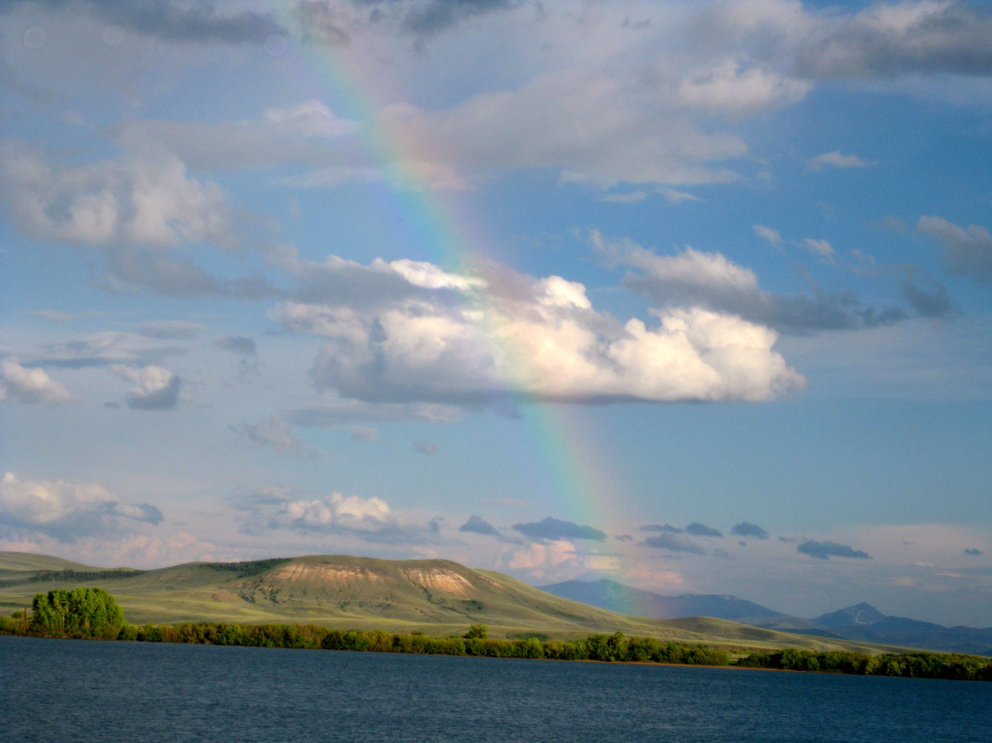
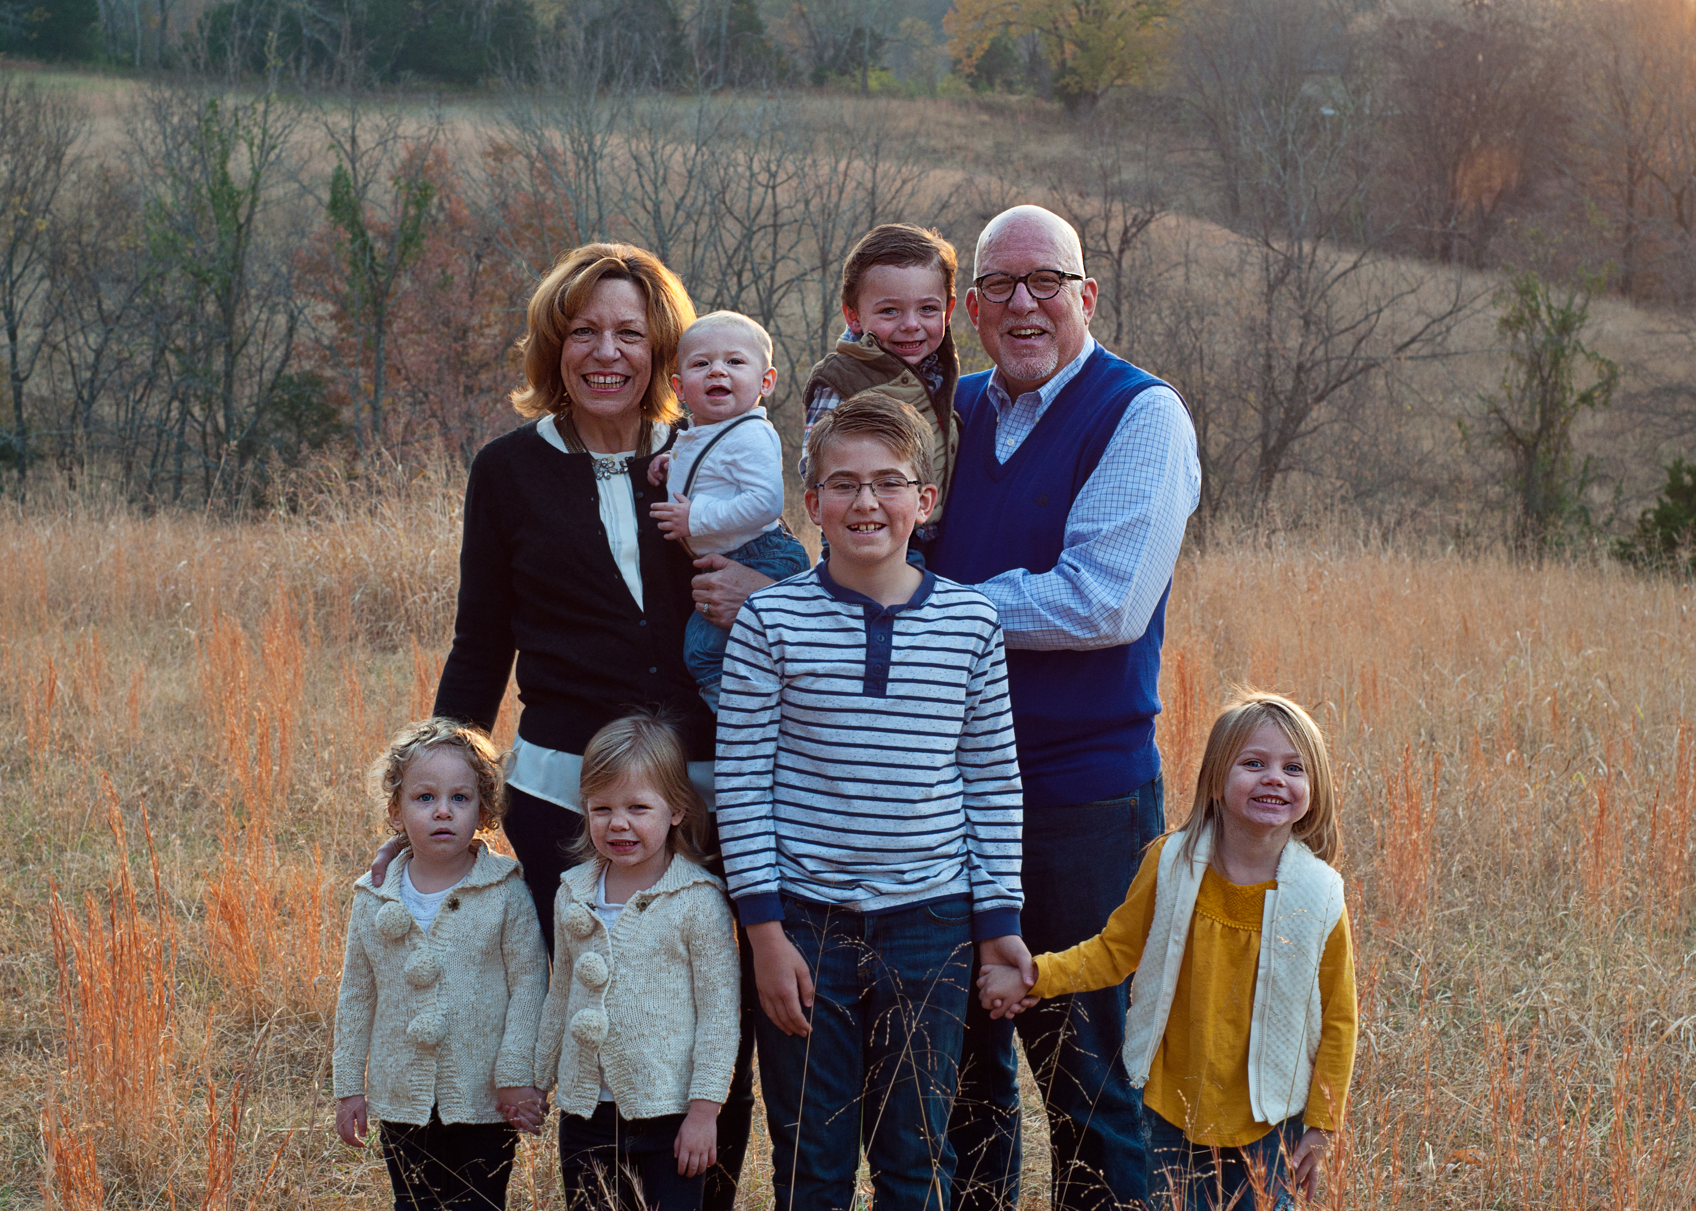
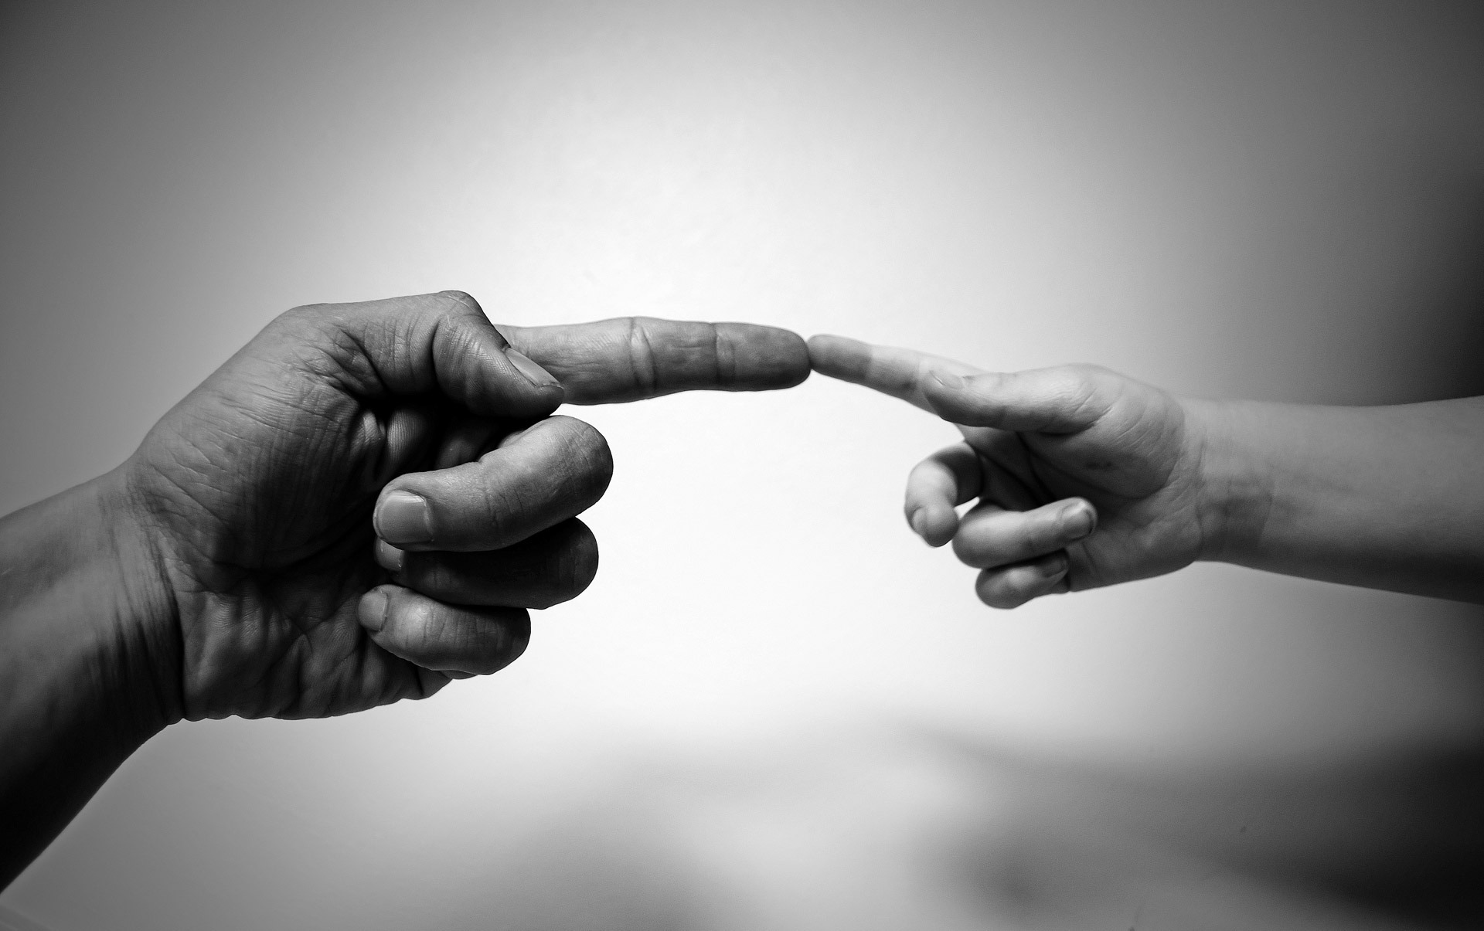
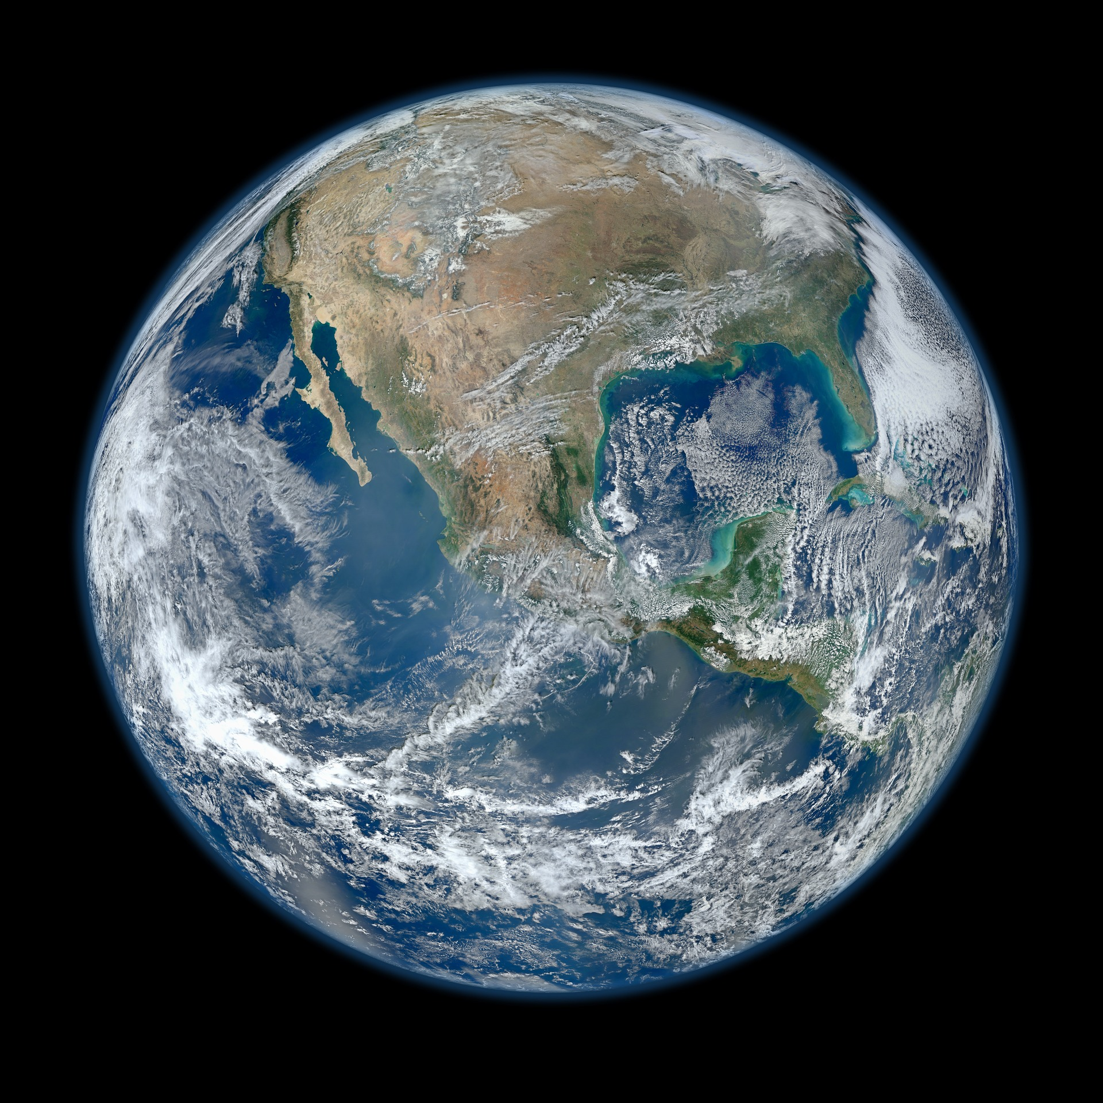
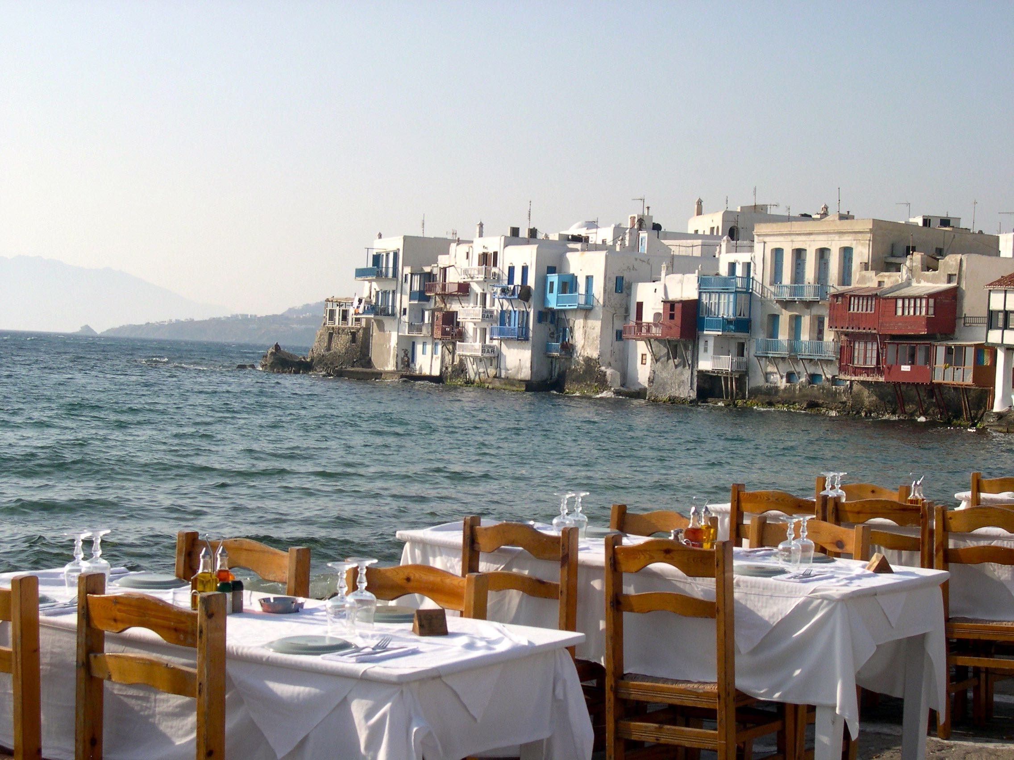
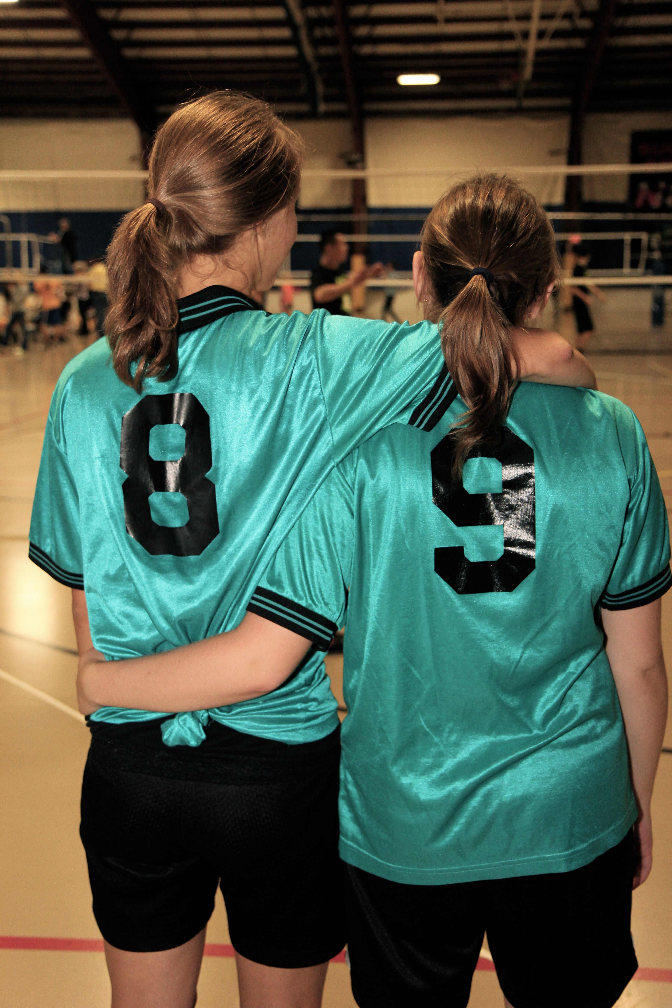
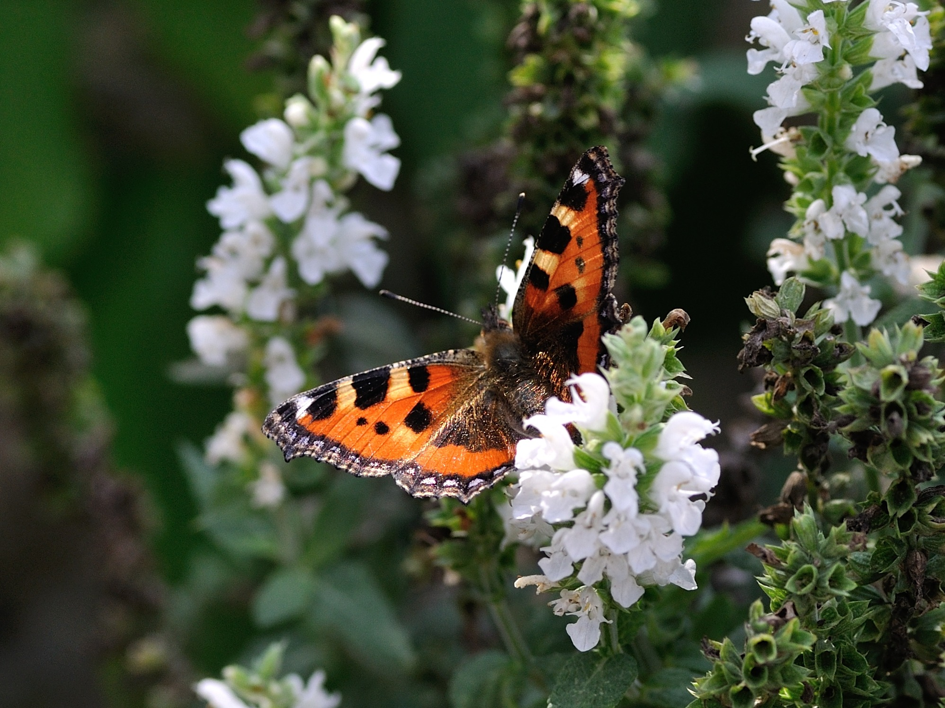
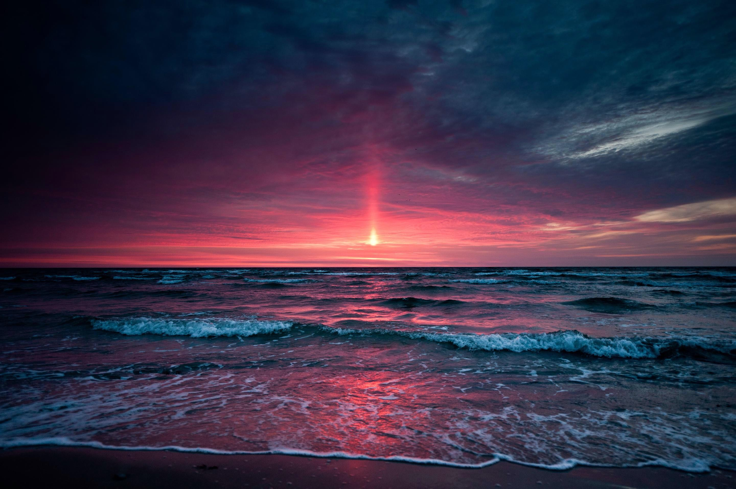
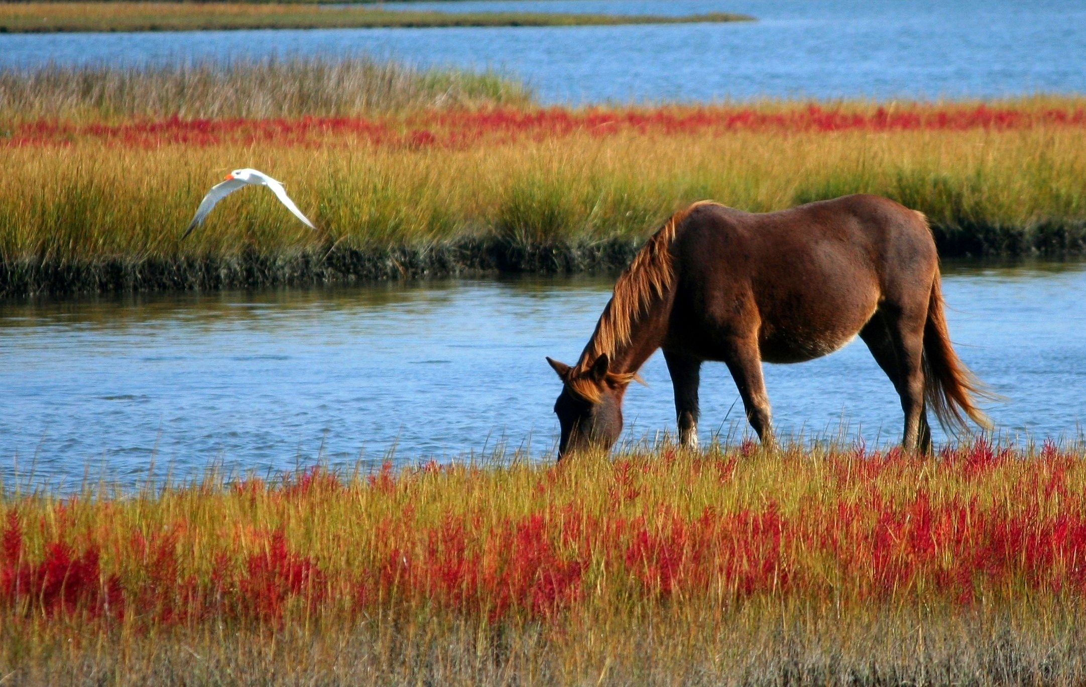

Slide 34
Revelation 21:1-7
Then I saw a new heaven and a new earth; for the first heaven and the first earth had passed away, and the sea was no more. And I saw the holy city, the new Jerusalem, coming down out of heaven from God, prepared as a bride adorned for her husband. And I heard a loud voice from the throne saying,
“See, the home of God is among mortals. God will dwell with them; they will be God’s peoples, and God himself will be with them; God will wipe every tear from their eyes. Death will be no more; mourning and crying and pain will be no more, for the first things have passed away.”
And the one who was seated on the throne said, “See, I am making all things new.” Also he said, “Write this, for these words are trustworthy and true.” ⁶Then he said to me, “It is done! I am the Alpha and the Omega, the beginning and the end. To the thirsty I will give water as a gift from the spring of the water of life. Those who conquer will inherit these things, and I will be their God and they will be my children.

Slide 35
QUESTIONS
What does this passage say about God’s “home”
What is the primary theme of the passage? Explain.
What does this passage tell us about how God desires for his people to thrive?
Choose a second image.
Which one shows God’s desire for your thriving as a church? For God’s world.

Slide 37
GATHER IDEAS
Gather the images that your team chose together—either physically or take screenshots or pics. After all images are gathered, take a moment to look at the collages of images.
Add the images from all your collages together, and look at them as a team.
What is the picture of thriving that God has in mind for your church?
Use your collage and the ”steps of thriving” from the early church template (next slide) to fill in the worksheet with your church’s direction for thriving.

Slide 38
The Steps from the Early Church Template
1. Churches loved Jesus
2. Churches focused on RELATIONSHIPS
They cared for the weak
They were deeply networked with other Christians
They shared their lives.
Church leaders addressed CONFLICTS
3. Churches focused on PRACTICING their faith.
4. Because of those faith practices, Christians were VISIBLE in their communities.
5. Churches helped God’s world to THRIVE.
Thriving Communities by Cavin Rowe and Greg Jones

